Slide 1
Welcome back!

Slide 2
Object Oriented Programming
Encapsulation
Classes encapsulate state (fields) and behavior (methods)
Polymorphism
Signature Polymorphism – Overloading
Subtype Polymorphism – Inheritance

Slide 3
Gets and sets
Instead of accessing data fields directly
ball.x = 5;
Define methods to access them
int getX () { return x;}
int getFoo () { return foo;}
void setX(int x) {this.x = x;}
void setFoo(int foo) {this.foo = foo;}
ball.setX(5);

Slide 4
Creating a set of Graphic Object Classes
All have…
X, Y location
width and height fields
fill and stroke colors
A draw() method
A next() method defining how they move
…
Implementation varies from class to class

Slide 5
Creating a set of Graphic Object Classes
Problems
How would you hold all your objects?
Array?
What if one class had extra methods or special arguments?
Sometimes you want to think of an object as a generic Graphic (X,Y location and draw() method)
Sometimes you want to think of an object as a specific type (extra methods, extra fields, …)

Slide 6
Graphic Object Hierarchy
Graphic
X,Y fields
draw() method …
Rectangle
Ellipse
Arc
Curve
Shape
More Specific
More General
Square
Circle
diameter
Inheritance gives you a way to relate your objects in a hierarchical manner

Slide 7
Inheritance
Superclass (base class) – higher in the hierarchy
Subclass (child class) – lower in the hierarchy
A subclass is derived from from a superclass
Subclasses inherit the fields and methods of their superclass.
I.e. subclasses automatically "get" stuff in superclasses
Subclasses can override a superclass method by redefining it.
They can replace anything by redefining locally

Slide 8
// Ellipse base class
class Ellipse {
float X;
float Y;
float W;
float H;
// Ellipses are always red
color fillColor =
color(255,0,0);
Ellipse(float X, float Y,
float W, float H)
{
this.X = X;
this.Y = Y;
this.W = W;
this.H = H;
}
void draw() {
ellipseMode(CENTER);
fill(fillColor);
ellipse(X, Y, W, H);
}
}
// Circle derived class
class Circle extends Ellipse {
Circle(float X, float Y, float D) {
super(X, Y, D, D);
// Circles are always green
fillColor = color(0,255,0);
}
}
The extends keyword creates hierarchical relationship between classes.
The Circle class gets all fields and methods of the Ellipse class, automatically.
The super keyword refers to the base class in the relationship.
The this keyword refers to the object itself.
Graphics.pde

Slide 9
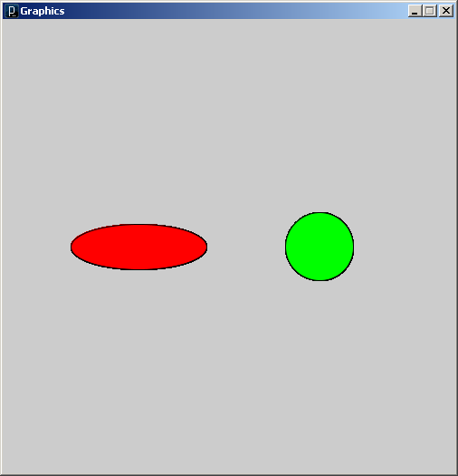
// Graphics
Ellipse e = new Ellipse(150, 250, 150, 50);
Circle c = new Circle(350, 250, 75);
void setup() {
size(500, 500);
smooth();
}
void draw() {
e.draw();
c.draw();
}
Graphics.pde

Slide 10
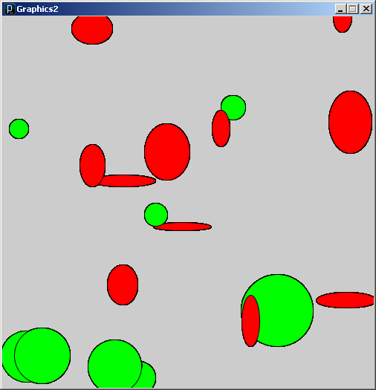
// Graphics2
Ellipse[] e = new Ellipse[20];
void setup() {
size(500, 500);
smooth();
for (int i=0; i<e.length; i++) {
float X = random(0, width);
float Y = random(0, height);
float W = random(10, 100);
float H = random(10, 100);
// Ellipses are Circles are
// stored in the same array
if (random(1.0) < 0.5)
e[i] = new Ellipse(X,Y,W,H);
else
e[i] = new Circle(X,Y,W);
}
}
void draw() {
for (int i=0; i<e.length; i++)
e[i].draw();
}
Ellipses and Circles in the same array!
Graphics2.pde

Slide 11
// Ellipse base class
class Ellipse {
float X;
float Y;
float W;
float H;
// Ellipses are always red
color fillColor =
color(255,0,0);
Ellipse(float X, float Y,
float W, float H)
{
this.X = X;
this.Y = Y;
this.W = W;
this.H = H;
}
void draw() {
ellipseMode(CENTER);
fill(fillColor);
ellipse(X, Y, W, H);
}
// Do nothing
void mousePressed() {}
}
// Circle derived class
class Circle extends Ellipse {
Circle(float X, float Y, float D) {
super(X, Y, D, D);
// Circles are always green
fillColor = color(0,255,0);
}
// Change color of circle when clicked
void mousePressed() {
if (dist(mouseX, mouseY, X, Y) < 0.5*W)
fillColor = color(0,0,255);
}
}
The mousePressed behavior of the Circle class overrides the default behavior of the Ellipse class.
Graphics3.pde

Slide 12
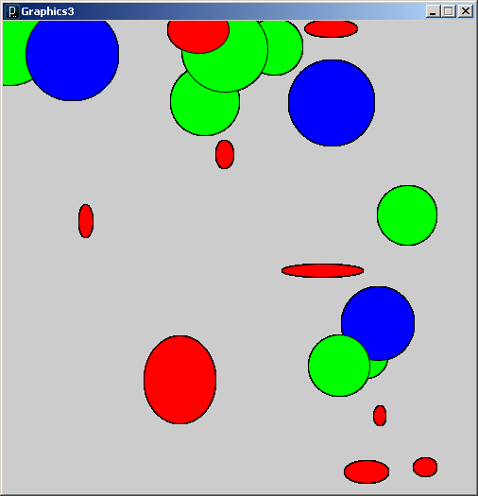
// Graphics3
Ellipse[] e = new Ellipse[20];
void setup() {
size(500, 500);
smooth();
// Stuff removed …
}
void draw() {
for (int i=0; i<e.length; i++)
e[i].draw();
}
void mousePressed() {
for (int i=0; i<e.length; i++)
e[i].mousePressed();
}
Graphics3.pde

Slide 13
A few more rules about inheritance …
A child’s constructor is responsible for calling the parent’s constructor
The first line of a child’s constructor should use the super reference to call the parent’s constructor
The super reference can also be used to reference other variables and methods defined in the parent’s class

Slide 14
Use inheritance to solve our aquarium problem
The AnimatedObject class has two methods that need to be overridden.
void display(), void move()
AnimatedObject
…
DxuObj
EmailusernameObj

