Slide 1
Review
Inheritance
Overloading and overriding

Slide 2
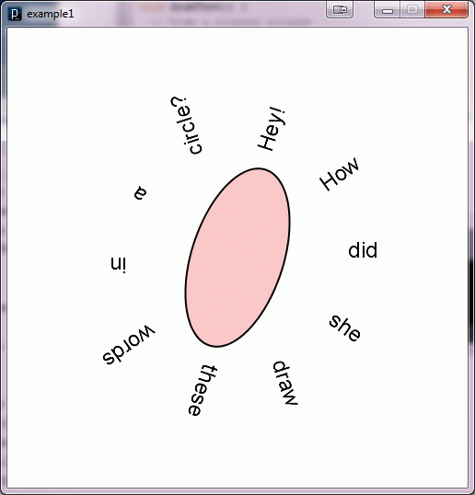
example1.pde

Slide 3
Up until now …
All movement and sizing of graphical objects have been accomplished by modifying object coordinate values.
Going forward, we have a new option…
We can leave coordinate values unchanged, and modify the coordinate system in which we draw.

Slide 4
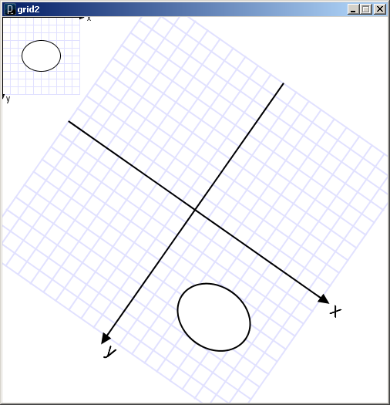
The commands that draw these two ellipses are identical.
What has changed is the coordinate system in which they are drawn.

Slide 5
Three ways to transform the coordinate system:
Scale
Magnify, zoom in, zoom out …
Translate
Move axes left, right, up, down …
Rotate
Tilt clockwise, tilt counter-clockwise …

Slide 6
Scale
All coordinates are multiplied by an x-scale-factor and a y-scale-factor.
Stroke thickness is also scaled.
scale( factor );
scale( x-factor, y-factor );

Slide 7
void setup() {
size(500, 500);
smooth();
noLoop();
line(1, 1, 25, 25);
}
example2.pde

Slide 8
void setup() {
size(500, 500);
smooth();
noLoop();
scale(2,2);
line(1, 1, 25, 25);
}
example2.pde

Slide 9
void setup() {
size(500, 500);
smooth();
noLoop();
scale(20,20);
line(1, 1, 25, 25);
}
example2.pde

Slide 10
void setup() {
size(500, 500);
smooth();
noLoop();
scale(2,5);
line(1, 1, 25, 25);
}
example2.pde

Slide 11
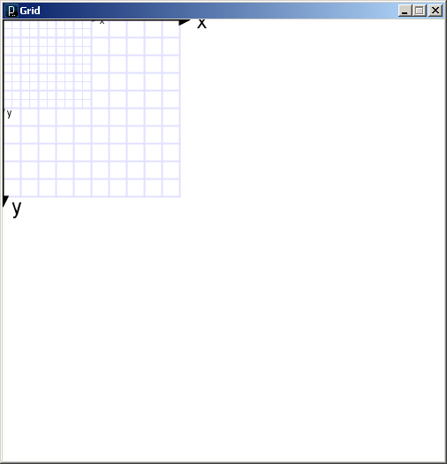
void setup() {
size(500, 500);
background(255);
smooth();
noLoop();
}
void draw() {
grid();
scale(2,2);
grid();
}
grid1.pde

Slide 12
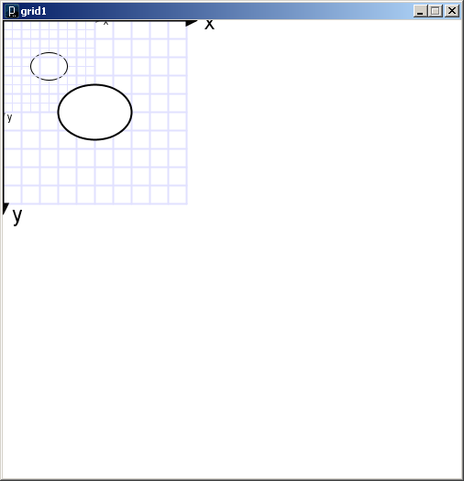
void draw() {
grid();
fill(255);
ellipse(50,50,40,30);
scale(2,2);
grid();
fill(255);
ellipse(50,50,40,30);
}
grid1.pde

Slide 13
Translate
The coordinate system is shifted by the given amount in the x and y directions.
translate( x-shift, y-shift);

Slide 14
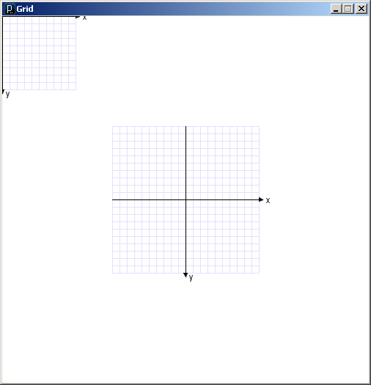
void draw() {
grid();
translate(250,250);
grid();
}
(250, 250)
grid2.pde

Slide 15
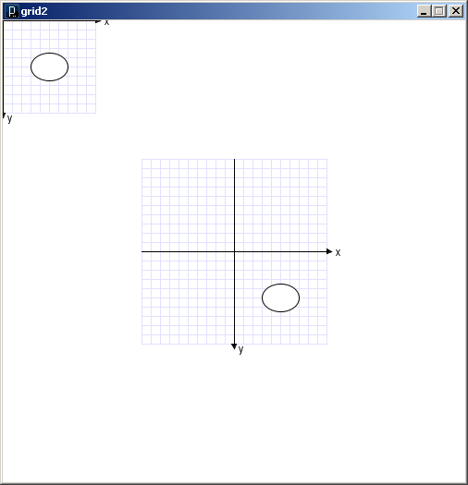
void draw() {
grid();
fill(255);
ellipse(50, 50, 40, 30);
translate(250, 250);
grid();
fill(255);
ellipse(50, 50, 40, 30);
}

Slide 16
Transformations can be combined
Combine Scale and Translate to create a coordinate system with the y-axis that increases in the upward direction
Axes can be flipped using negative scale factors

Slide 17
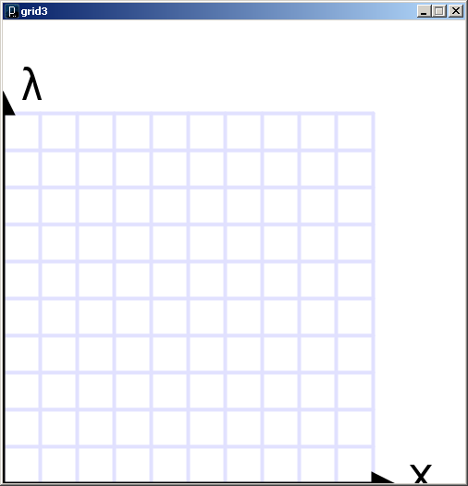
void draw() {
translate(0,height);
scale(4,-4);
grid();
}
grid3.pde

Slide 18
Rotate
The coordinate system is rotated around the origin by the given angle (in radians).
rotate( radians );

Slide 19
void draw() {
rotate( 25.0 * (PI/180.0) );
grid();
}
grid4.pde

Slide 20
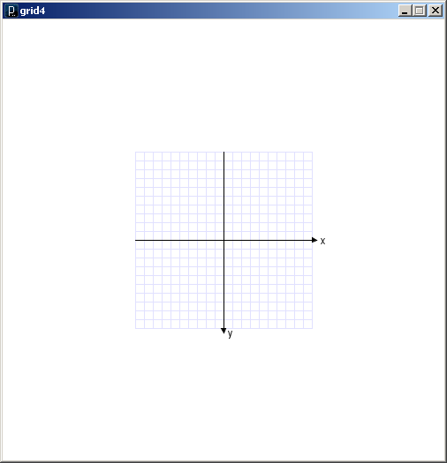
void draw() {
translate(250.0, 250.0);
//rotate( 25.0 * (PI/180.0) );
//scale( 2 );
grid();
}
grid4.pde

Slide 21
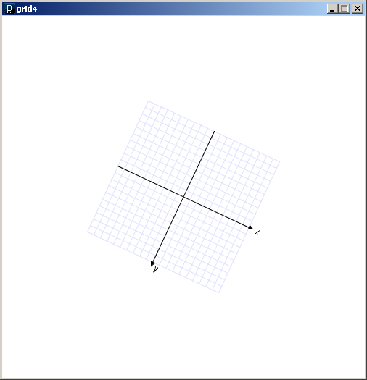
void draw() {
translate(250.0, 250.0);
rotate( 25.0 * (PI/180.0) );
//scale( 2 );
grid();
}
grid4.pde

Slide 22
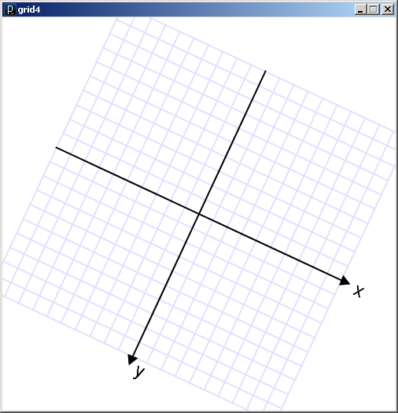
void draw() {
translate(250.0, 250.0);
rotate( 25.0 * (PI/180.0) );
scale( 2 );
grid();
}
grid4.pde

Slide 23
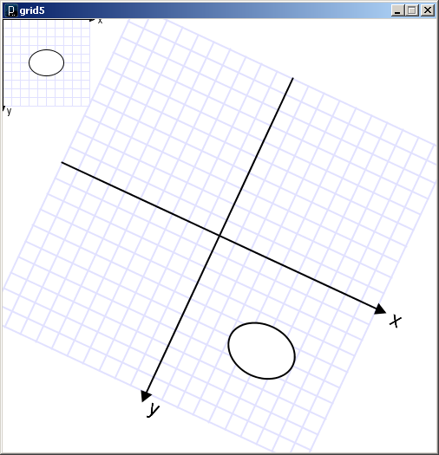
void draw() {
grid();
fill(255);
ellipse(50, 50, 40, 30);
translate(250.0, 250.0);
rotate( 25.0 * (PI/180.0) );
scale(2);
grid();
fill(255);
ellipse(50, 50, 40, 30);
}
grid5.pde

Slide 24
Some things to note:
Transformations do NOT work within beginShape()/endShape();
Transformations are cumulative.
All transformations are cancelled prior to calling draw().
You can save and restore the current state of the coordinate system by calling
pushMatrix();
popMatrix();

Slide 25
String[] word = new String[]
{"A","B","C","D","E","F","G","H","I","J","K","L","M","N","O","P","Q","R","S","T","U","V","W","X","Y","Z","0","1","2","3","4","5","6","7","8","9"};
void setup() {
size(500, 500);
smooth();
noLoop();
}
void draw() {
background(255);
translate(250,250);
fill(0);
for (int i=0; i<word.length; i++) {
text( word[i], 0.0, -150.0 );
rotate(radians(10));
}
}
Each time through the loop an additional 10 degrees is added to the rotation angle.
Total rotation accumulates.
example3.pde

Slide 26
String[] word = new String[]
{"A","B","C","D","E","F","G","H","I","J","K","L","M","N","O","P","Q","R","S","T","U","V","W","X","Y","Z","0","1","2","3","4","5","6","7","8","9"};
float start = 0.0;
void setup() {
size(500, 500);
smooth();
}
void draw() {
background(255);
translate(250,250);
fill(0);
rotate(start);
for (int i=0; i<word.length; i++) {
text( word[i], 0.0, -150.0 );
rotate(radians(10));
}
start += radians(1);
}
Each time through the loop an initial rotation angle is set, incremented, and saved in a global.
Transformations reset each time draw() is called.
example4.pde

Slide 27
Transformations work in 3D
Z is depth (into or out of the screen)
Negative z goes into the screen
translate(0, 0, -100);
Translate(0, 0, 100);
If using 3D transformations
Change to 3D coordinates
Add a third argument to size to change the default renderer to P3D or OPENGL
import processing.opengl.*
-Z
+X
+Y

Slide 28
A starfield using matrix transformations
starfield.pde

Slide 29
x
z
We want to find the point
where each star is projected
on our viewport.
x'
z'

