Slide 1
Review
Transformations
Scale
Translate
Rotate
Combining Transformations
Transformations are cumulative
Rotating about the center of an object
Animating with transformations

Slide 2
Factorial
The factorial of a positive integer N is computed as the product of N with all positive integers less than or equal to N.
4! = 4 × 3 × 2 × 1 = 24
30! = 30 × 29 × … × 2 × 1 = 265252859812191058636308480000000

Slide 3
Factorial - Iterative Implementation
void setup() {
int A = 10;
int B = factorial(5);
println( B );
}
int factorial(int N) {
int F = 1;
for( int i=N; i>=1; i--) {
F = F * i;
}
return F;
}
Trace it.

Slide 4
5! = 5 × 4 × 3 × 2 × 1
4! = 4 × 3 × 2 × 1
5! = 5 × 4!
N! = N × (N-1)!
Factorial can be defined in terms of itself

Slide 5
Factorial – Recursive Implementation
void setup() {
int A = 10;
int B = factorial(5);
println( B );
}
int factorial(int N) {
if (N == 1) {
return 1;
} else {
int F = N * factorial(N-1);
return F;
}
}
Trace it.

Slide 6
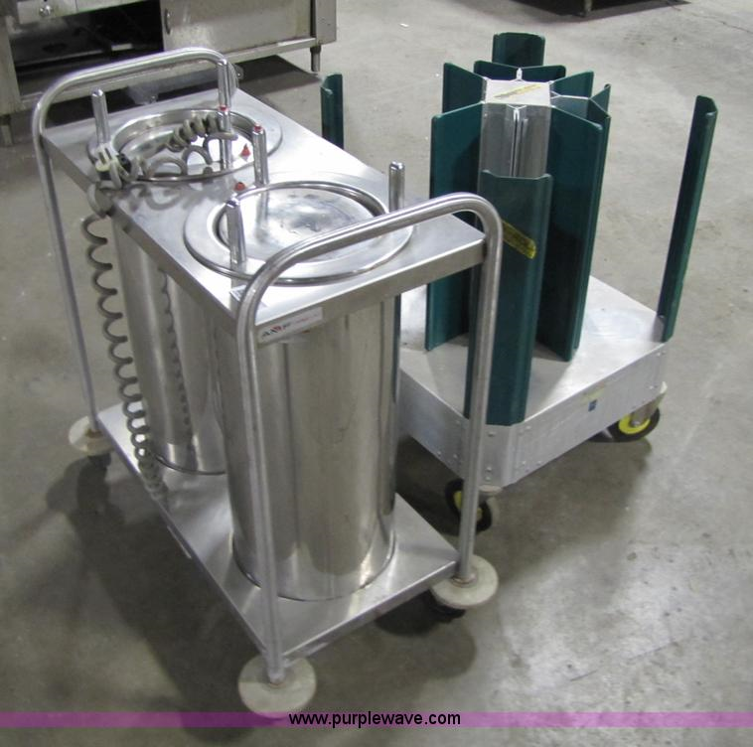
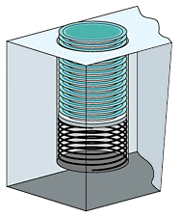
Last In First Out (LIFO) Stack of Plates

Slide 7
Compiled Code
Executing Function
Call Stack
void setup() {
int A = 10;
int B = factorial(5);
println( B );
}
int factorial(int N) {
if (N == 1) {
return 1;
} else {
int F = N * factorial(N-1);
return F;
}
}

Slide 8
Compiled Code
Executing Function
Call Stack
void setup() {
int A = 10;
int B = factorial(5);
println( B );
}
void setup() {
int A = 10;
int B = factorial(5);
println( B );
}
int factorial(int N) {
if (N == 1) {
return 1;
} else {
int F = N * factorial(N-1);
return F;
}
}

Slide 9
Compiled Code
Executing Function
Call Stack
void setup() {
int A = 10;
int B = factorial(5);
println( B );
}
void setup() {
int A = 10;
int B = factorial(5);
println( B );
}
int factorial(int N) {
if (N == 1) {
return 1;
} else {
int F = N * factorial(N-1);
return F;
}
}

Slide 10
Compiled Code
Executing Function
Call Stack
void setup() {
int A = 10;
int B = factorial(5);
println( B );
}
void setup() {
int A = 10;
int B = factorial(5);
println( B );
}
setup()
A=10, Line=3
int factorial(int N) {
if (N == 1) {
return 1;
} else {
int F = N * factorial(N-1);
return F;
}
}

Slide 11
Compiled Code
Executing Function
Call Stack
int factorial(int N=5) {
if (N == 1) {
return 1;
} else {
int F = N * factorial(N-1);
return F;
}
}
void setup() {
int A = 10;
int B = factorial(5);
println( B );
}
setup()
A=10, Line=3
int factorial(int N) {
if (N == 1) {
return 1;
} else {
int F = N * factorial(N-1);
return F;
}
}

Slide 12
Compiled Code
Executing Function
Call Stack
int factorial(int N=5) {
if (N == 1) {
return 1;
} else {
int F = N * factorial(N-1);
return F;
}
}
void setup() {
int A = 10;
int B = factorial(5);
println( B );
}
setup()
A=10, Line=3
int factorial(int N) {
if (N == 1) {
return 1;
} else {
int F = N * factorial(N-1);
return F;
}
}

Slide 13
Compiled Code
Executing Function
Call Stack
int factorial(int N=5) {
if (N == 1) {
return 1;
} else {
int F = N * factorial(N-1);
return F;
}
}
void setup() {
int A = 10;
int B = factorial(5);
println( B );
}
factorial()
N=5, Line=5
setup()
A=10, Line=3
int factorial(int N) {
if (N == 1) {
return 1;
} else {
int F = N * factorial(N-1);
return F;
}
}

Slide 14
Compiled Code
Executing Function
Call Stack
int factorial(int N=4) {
if (N == 1) {
return 1;
} else {
int F = N * factorial(N-1);
return F;
}
}
void setup() {
int A = 10;
int B = factorial(5);
println( B );
}
factorial()
N=5, Line=5
setup()
A=10, Line=3
int factorial(int N) {
if (N == 1) {
return 1;
} else {
int F = N * factorial(N-1);
return F;
}
}

Slide 15
Compiled Code
Executing Function
Call Stack
int factorial(int N=4) {
if (N == 1) {
return 1;
} else {
int F = N * factorial(N-1);
return F;
}
}
void setup() {
int A = 10;
int B = factorial(5);
println( B );
}
factorial()
N=5, Line=5
setup()
A=10, Line=3
int factorial(int N) {
if (N == 1) {
return 1;
} else {
int F = N * factorial(N-1);
return F;
}
}

Slide 16
Compiled Code
Executing Function
Call Stack
int factorial(int N=4) {
if (N == 1) {
return 1;
} else {
int F = N * factorial(N-1);
return F;
}
}
void setup() {
int A = 10;
int B = factorial(5);
println( B );
}
factorial()
N=4, Line=5
factorial()
N=5, Line=5
int factorial(int N) {
if (N == 1) {
return 1;
} else {
int F = N * factorial(N-1);
return F;
}
}
setup()
A=10, Line=3

Slide 17
Compiled Code
Executing Function
Call Stack
int factorial(int N=3) {
if (N == 1) {
return 1;
} else {
int F = N * factorial(N-1);
return F;
}
}
void setup() {
int A = 10;
int B = factorial(5);
println( B );
}
factorial()
N=4, Line=5
factorial()
N=5, Line=5
int factorial(int N) {
if (N == 1) {
return 1;
} else {
int F = N * factorial(N-1);
return F;
}
}
setup()
A=10, Line=3

Slide 18
Compiled Code
Executing Function
Call Stack
int factorial(int N=3) {
if (N == 1) {
return 1;
} else {
int F = N * factorial(N-1);
return F;
}
}
void setup() {
int A = 10;
int B = factorial(5);
println( B );
}
factorial()
N=4, Line=5
factorial()
N=5, Line=5
int factorial(int N) {
if (N == 1) {
return 1;
} else {
int F = N * factorial(N-1);
return F;
}
}
setup()
A=10, Line=3

Slide 19
Compiled Code
Executing Function
Call Stack
int factorial(int N=3) {
if (N == 1) {
return 1;
} else {
int F = N * factorial(N-1);
return F;
}
}
void setup() {
int A = 10;
int B = factorial(5);
println( B );
}
factorial()
N=3, Line=5
factorial()
N=4, Line=5
int factorial(int N) {
if (N == 1) {
return 1;
} else {
int F = N * factorial(N-1);
return F;
}
}
factorial()
N=5, Line=5
setup()
A=10, Line=3

Slide 20
Compiled Code
Executing Function
Call Stack
int factorial(int N=2) {
if (N == 1) {
return 1;
} else {
int F = N * factorial(N-1);
return F;
}
}
void setup() {
int A = 10;
int B = factorial(5);
println( B );
}
factorial()
N=3, Line=5
factorial()
N=4, Line=5
int factorial(int N) {
if (N == 1) {
return 1;
} else {
int F = N * factorial(N-1);
return F;
}
}
factorial()
N=5, Line=5
setup()
A=10, Line=3

Slide 21
Compiled Code
Executing Function
Call Stack
int factorial(int N=2) {
if (N == 1) {
return 1;
} else {
int F = N * factorial(N-1);
return F;
}
}
void setup() {
int A = 10;
int B = factorial(5);
println( B );
}
factorial()
N=3, Line=5
factorial()
N=4, Line=5
int factorial(int N) {
if (N == 1) {
return 1;
} else {
int F = N * factorial(N-1);
return F;
}
}
factorial()
N=5, Line=5
setup()
A=10, Line=3

Slide 22
Compiled Code
Executing Function
Call Stack
int factorial(int N=2) {
if (N == 1) {
return 1;
} else {
int F = N * factorial(N-1);
return F;
}
}
void setup() {
int A = 10;
int B = factorial(5);
println( B );
}
factorial()
N=2, Line=5
factorial()
N=3, Line=5
int factorial(int N) {
if (N == 1) {
return 1;
} else {
int F = N * factorial(N-1);
return F;
}
}
factorial()
N=4, Line=5
factorial()
N=5, Line=5
setup()
A=10, Line=3

Slide 23
Compiled Code
Executing Function
Call Stack
int factorial(int N=1) {
if (N == 1) {
return 1;
} else {
int F = N * factorial(N-1);
return F;
}
}
void setup() {
int A = 10;
int B = factorial(5);
println( B );
}
factorial()
N=2, Line=5
factorial()
N=3, Line=5
int factorial(int N) {
if (N == 1) {
return 1;
} else {
int F = N * factorial(N-1);
return F;
}
}
factorial()
N=4, Line=5
factorial()
N=5, Line=5
setup()
A=10, Line=3

Slide 24
Compiled Code
Executing Function
Call Stack
int factorial(int N=1) {
if (N == 1) {
return 1;
} else {
int F = N * factorial(N-1);
return F;
}
}
void setup() {
int A = 10;
int B = factorial(5);
println( B );
}
factorial()
N=2, Line=5
factorial()
N=3, Line=5
int factorial(int N) {
if (N == 1) {
return 1;
} else {
int F = N * factorial(N-1);
return F;
}
}
factorial()
N=4, Line=5
factorial()
N=5, Line=5
setup()
A=10, Line=3

Slide 25
Compiled Code
Executing Function
Call Stack
int factorial(int N=2) {
if (N == 1) {
return 1;
} else {
int F = N * 1;
return F;
}
}
void setup() {
int A = 10;
int B = factorial(5);
println( B );
}
factorial()
N=3, Line=5
factorial()
N=4, Line=5
int factorial(int N) {
if (N == 1) {
return 1;
} else {
int F = N * factorial(N-1);
return F;
}
}
factorial()
N=5, Line=5
setup()
A=10, Line=3

Slide 26
Compiled Code
Executing Function
Call Stack
int factorial(int N=3) {
if (N == 1) {
return 1;
} else {
int F = N * 2;
return F;
}
}
void setup() {
int A = 10;
int B = factorial(5);
println( B );
}
factorial()
N=4, Line=5
factorial()
N=5, Line=5
int factorial(int N) {
if (N == 1) {
return 1;
} else {
int F = N * factorial(N-1);
return F;
}
}
setup()
A=10, Line=3

Slide 27
Compiled Code
Executing Function
Call Stack
int factorial(int N=4) {
if (N == 1) {
return 1;
} else {
int F = N * 6;
return F;
}
}
void setup() {
int A = 10;
int B = factorial(5);
println( B );
}
factorial()
N=5, Line=5
setup()
A=10, Line=3
int factorial(int N) {
if (N == 1) {
return 1;
} else {
int F = N * factorial(N-1);
return F;
}
}

Slide 28
Compiled Code
Executing Function
Call Stack
int factorial(int N=5) {
if (N == 1) {
return 1;
} else {
int F = N * 24;
return F;
}
}
void setup() {
int A = 10;
int B = factorial(5);
println( B );
}
setup()
A=10, Line=3
int factorial(int N) {
if (N == 1) {
return 1;
} else {
int F = N * factorial(N-1);
return F;
}
}

Slide 29
Compiled Code
Executing Function
Call Stack
void setup() {
int A = 10;
int B = 120;
println( B );
}
void setup() {
int A = 10;
int B = factorial(5);
println( B );
}
int factorial(int N) {
if (N == 1) {
return 1;
} else {
int F = N * factorial(N-1);
return F;
}
}

Slide 30
The Call Stack keeps track of …
all functions that are suspended, in order
the point in the function where execution should resume after the invoked subordinate function returns
a snapshot of all variables and values within the scope of the suspended function so these can be restored upon continuing execution

Slide 31
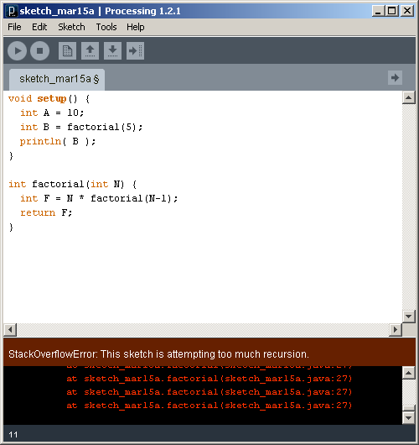
What happens if there is no stopping condition, or "base case"?

Slide 32
// Fibonacci sequence
// 0, 1, 1, 2, 3, 5, 8, 13, 21, 34, 55, 89, 144, ...
void setup() {}
void draw() {}
void mousePressed() {
int f = fibonacci(12);
println(f);
}
// Compute and return the nth Fibonacci number
int fibonacci(int n) {
if (n == 0) {
return 0;
} else if (n == 1) {
return 1;
} else {
int f = fibonacci(n-1) + fibonacci(n-2);
return f;
}
}

Slide 33
Creating a maze, recursively
Start with a rectangular region defined by its upper left and lower right corners
Divide the region at a random location through its more narrow dimension
Add an opening at a random location
Repeat on two rectangular subregions
Inspired by http://weblog.jamisbuck.org/2011/1/12/maze-generation-recursive-division-algorithm

Slide 34
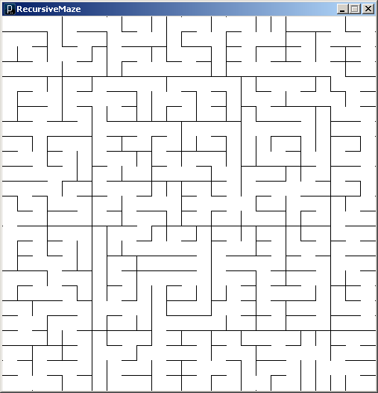

Slide 35
// RecursiveMaze
int N = 25; // Grid dimension
int gsize = 20; // Grid size
int V = 1; // Vertical constant
int H = 2; // Horizontal constant
void setup() {
// Setup sketch
size(N*gsize+1, N*gsize+1);
noLoop();
background(255);
stroke(0);
// Kick off the recursive divide
// on entire sketch window
divide(0,0,N,N);
}
// Determine the direction for dividing
// Stop when too small.
int divDir(int r1, int c1, int r2, int c2) {
int dr = r2 - r1; // Deltas
int dc = c2 - c1;
if (dr <= 1 || dc <= 1) // Too small
return 0; // No division
else if (dr < dc) // Flat and wide
return V; // Vertical division
else // Tall and narrow
return H; // Horizontal div
}
// Return a random integer in the range
int randomInt(int min, int max) {
return round(random(min-0.5,max+0.5));
}
// Draw a line on a grid segment
void gridLine(int r1, int c1, int r2, int c2) {
line(r1*gsize, c1*gsize, r2*gsize, c2*gsize);
}

Slide 36
// Divide the region given upper left and
// lower right grid corner points
void divide(int r1, int c1, int r2, int c2) {
int cr, rr;
// Get divide direction (V, H or 0)
int dir = divDir(r1, c1, r2, c2);
// Divide in vertical direction
if (dir == V) {
// Wall and opening locations
cr = randomInt(c1+1, c2-1);
rr = randomInt(r1, r2-1);
// Draw wall
gridLine(cr,r1,cr,rr);
gridLine(cr,rr+1,cr,r2);
// Recursively divide two subregions
divide(r1,c1,r2,cr);
divide(r1,cr,r2,c2);
// Divide in horizontal direction
} else if (dir == H) {
// Wall and opening locations
cr = randomInt(c1, c2-1);
rr = randomInt(r1+1, r2-1);
// Draw wall
gridLine(c1,rr,cr,rr);
gridLine(cr+1,rr,c2,rr);
// Recursively divide two subregions
divide(r1,c1,rr,c2);
divide(rr,c1,r2,c2);
// No division. We're done.
} else {
return;
}
}

