Slide 1
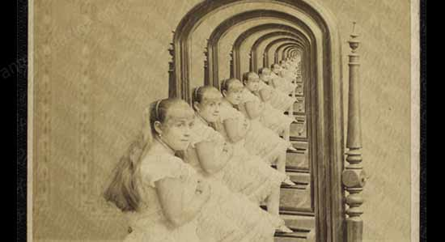
Review
Recursion
Call Stack

Slide 2
Two-dimensional Arrays
Visualized as a grid
int[][] grays = {{0, 20, 40},
{60, 80, 100},
{120, 140, 160},
{180, 200, 220}};
int[][] grays= new int[4][3];

Slide 3
Processing 2D Arrays
Need two indices, one for the rows and one for the columns.
int[][] grays = {{0, 20, 40},
{60, 80, 100},
{120, 140, 160},
{180, 200, 220}};
grays[2][1] = 255;
grays[2][3] = 0;

Slide 4
Lengths of 2D Arrays
int[][] grays = new int[80][100];
println(grays.length);
println(grays[0].length);

Slide 5
Cellular Automata
A regular grid of Cells
Cell
Two States
On
Off
Neighborhood
Cell states
evolve over time according to a predefined set of rules.

Slide 6
Sample Set of Rules – Conway's Game of Life
1. Any live cell with fewer than two live neighbors dies, as if caused by under-population.
2. Any live cell with two or three live neighbors lives on to the next generation.
3. Any live cell with more than three live neighbors dies, as if by overcrowding.
4. Any dead cell with exactly three live neighbors becomes a live cell, as if by reproduction.
An example of "Emergence"
http://en.wikipedia.org/wiki/Conway%27s_game_of_life

Slide 7
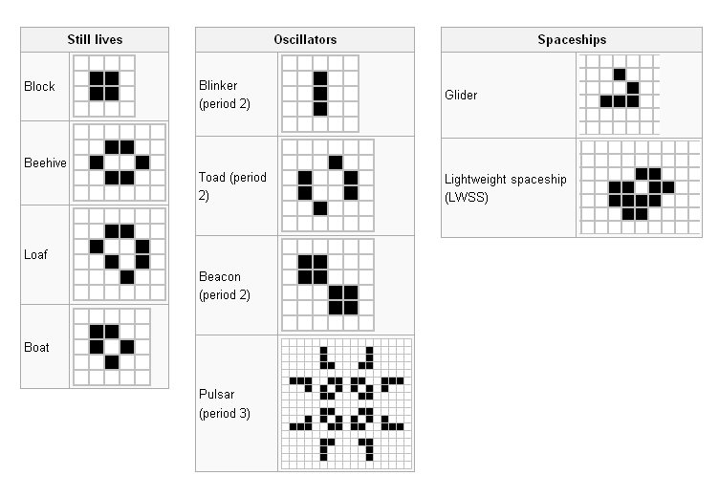
Interesting Patterns – Conway's Game of Life
http://en.wikipedia.org/wiki/Conway%27s_game_of_life

Slide 8
current
next
Top-level procedure
Draw the current grid
Advance game by applying rules to all cells of current and filling next
Swap current and next grid

Slide 9
int N = 5;
boolean[] cell = new boolean[N];
cell
false
⬅ One-dimensional array
0
false
1
false
2
false
3
false
4

Slide 10
int N = 5;
boolean[][] cell = new boolean[N][N];
cell
0
1
2
3
4
⬅ Two-dimensional array
… an array of arrays
0
false
false
false
false
false
0
1
2
3
4
1
false
false
false
false
false
0
1
2
3
4
2
false
false
false
false
false
0
1
2
3
4
3
false
false
false
false
false
0
1
2
3
4
4
false
false
false
false
false

Slide 11
int N = 5;
boolean[][] cell = new boolean[N][N];
cell[1][2] = true;
cell
0
1
2
3
4
false
false
false
false
false
0
false
false
true
false
false
1
false
false
false
false
false
2
false
false
false
false
false
3
false
false
false
false
false
4

Slide 12
current: cell[r][c][0]
next: cell[r][c][1]
// 3-Dimensional Array
int N = 50;
boolean[][][] cell = new boolean[N][N][2];
cell[1][2][0] = true;

Slide 14
Add the necessary lines of code within setup() to fill the vals array with random numbers of your choosing. Your implementation must use for loops.
float[][] vals;
void setup() {
vals = new float[20][300];
// Add your code here
} // Closing brace for setup()

Slide 15
float[][] vals;
void setup() {
vals = new float[20][300];
for (int i=0; i<20; i++) {
println( vals[i].length ); // What is going on here?
}
}

Slide 16
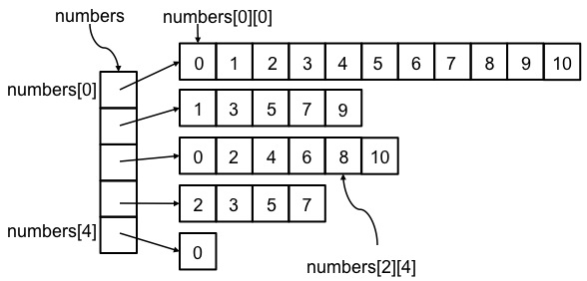
Ragged Arrays
int[][] numbers = {
{0, 1, 2, 3, 4, 5, 6, 7, 8, 9, 10},
{1, 3, 5, 7, 9},
{0, 2, 4, 6, 8, 10},
{2, 3, 5, 7},
{0},
};

Slide 17
float[][] grays = new float[100][100];
int cellSize = 5;
void setup() {
size(500, 500);
for (int i=0; i<grays.length; i++) {
for (int j=0; j<grays[i].length; j++) {
grays[i][j] = int(random(255));
}
}
for (int i=0; i<grays.length; i++) {
for (int j=0; j<grays[i].length; j++) {
fill(grays[i][j]);
pushMatrix();
translate(j*cellSize, i*cellSize);
rect(0, 0, cellSize, cellSize);
popMatrix();
}
}
}
Fill a 2D array with data and draw it to the sketch as grayscale levels.

Slide 18
Challenge
Modify the previous example to plot black squares whenever both the row and column of a cell are even.

