Slide 1
Image Processing
… computing with and about data,
… where "data" includes the values and relative locations of the colors that make up an image.

Slide 2
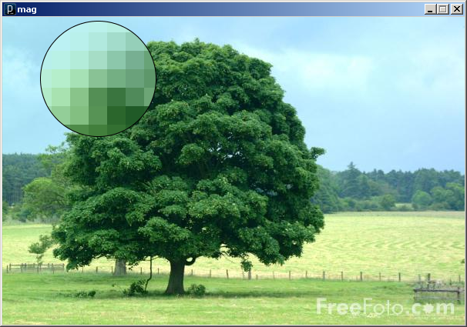
An image is an array of colors
0
1
2
3
…
98
99
100
101
102
103
…
198
199
200
201
202
203
…
298
299
300
301
302
303
…
398
399
400
401
402
403
…
498
499
500
501
502
503
…
598
599
600
601
602
603
…
698
699
700
701
702
703
…
798
799
800
801
802
803
…
898
899
…
…
…
…
…
…
…
Pixel : Picture Element
mag.pde

Slide 3
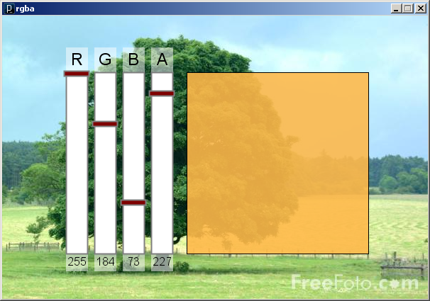
Color
A triple of bytes [0, 255]
RGB or HSB
Transparency (alpha)
How to blend a new pixel color with an existing pixel color
rgba.pde

Slide 4
Accessing the pixels of a sketch
loadPixels()
Loads the color data out of the sketch window into a 1D array of colors named pixels[]
The pixels[] array can be modified
updatePixels()
Copies the color data from the pixels[] array back to the sketch window

Slide 5
A 100-pixel wide image
First pixel at index 0
Right-most pixel in first row at index 99
First pixel of second row at index 100
0
1
2
3
…
98
99
100
101
102
103
…
198
199
200
201
202
203
…
298
299
300
301
302
303
…
398
399
400
401
402
403
…
498
499
500
501
502
503
…
598
599
600
601
602
603
…
698
699
700
701
702
703
…
798
799
800
801
802
803
…
898
899
…
…
…
…
…
…
…
The pixels[] array is one-dimensional
0
1
2
3
…
98
99
100
101
102
103
…
198
199
200
101
102
103
…

Slide 6
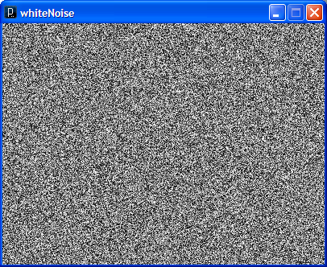
// whiteNoise
void setup() {
size(400, 300);
}
void draw() {
float b;
// Load colors into the pixels array
loadPixels();
// Fill pixel array with a random
// grayscale value
for (int i=0; i<pixels.length; i++) {
b = random(0, 255);
pixels[i] = color(b);
}
// Update the sketch with pixel data
updatePixels();
}
See also colorNoise.pde

Slide 7
Accessing Pixels as a 2D Array
Pixels can be accessed as a 2D array using the following formula:
index = r * width + c
index = y * width + x
Using 0-based indices
int idx = width*r + c;
pixels[idx] = color(b);

Slide 8
// cone
void setup() {
size(400, 400);
// Load colors into the pixels array
loadPixels();
// Access pixels as a 2D array
for (int y=0; y<height; y++) {
for (int x=0; x<width; x++) {
// Compute distance to center point
float d = dist(x, y, width/2, height/2);
// Set pixel as distance to center
pixels[y*height+x] = color(d);
}
}
// Update the sketch with pixel data
updatePixels();
}

Slide 9
Rendering Images in a Sketch
Image data can be loaded from a file using loadImage() method, and drawn on a sketch with the image() command
The PImage object also permits individual pixel color data to be modified.
like the sketch window
PImage img = loadImage("myImage.jpg");
image(img, 0, 0);

Slide 10
PImage
Fields
width - the width of the image
height - the height of the image
pixels[] - the image pixel colors
(after a call to loadPixels())

Slide 11
PImage
Methods
loadPixels()
Loads the color data out of the PImage object into a 1D array of colors named pixels[].
updatePixels()
Copies the color data from the pixels[] array back to the PImage object.
Also
red(color) extract the red component of from color
blue(color) extract the green component from a color
green(color) extract the blue component from a color

Slide 12
Basic Filters
Color
Extracting Red/Green/Blue colors
pixels[i] = color(red(c), 0, 0);
pixels[i] = color(0, 0, blue(c));
Grayscale
pixels[i] = color(0.3*red(c)+ 0.59*green(c)+ 0.11*blue(c));
Negative
pixels[i] = color(255-red(c), 255-green(c), 255-blue(c));

Slide 13
Sepia
Technique for archiving BW photos
float r = red(c)*0.393+green(c)*0.769+blue(c)*0.189;
float g = red(c)*0.349+green(c)*0.686+blue(c)*0.168;
float b = red(c)*0.272+green(c)*0.534+blue(c)*0.131;
pixels[i] = color(r, g, b);

Slide 14
PImage
Methods (Cont'd)
get(…) Reads the color of any pixel or grabs a rectangle of pixels
set(…) Writes a color to any pixel or writes an image into another
copy(…) Copies pixels from one part of an image to another
mask(…) Masks part of the image from displaying
save(…) Saves the image to a TIFF, TARGA, PNG, or JPEG file
resize(…) Changes the size of an image to a new width and height
blend(…) Copies a pixel or rectangle of pixels using different blending modes
filter(…) Processes the image using one of several algorithms

Slide 15
get(…)
Get a single pixel (very slow)
Color c = img.get(x, y);
Get a rectangular range of pixels
PImage img2 = img.get(x, y, w, h);

Slide 16
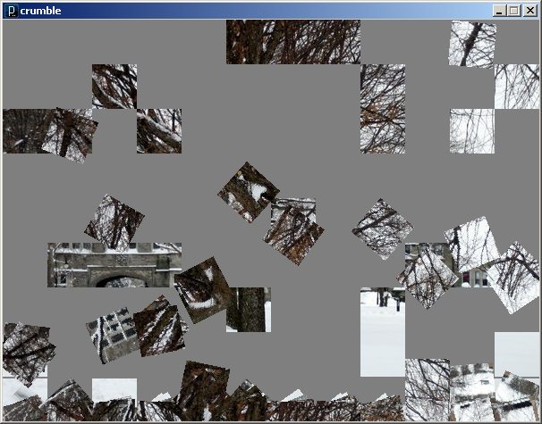

Slide 17
tint(…) / noTint()
tint() modifies the fill value for images
tint( gray );
tint( gray, alpha );
tint( red, green, blue );
tint( red, green, blue, alpha );
Turn off applied tint() values with noTint()

Slide 18
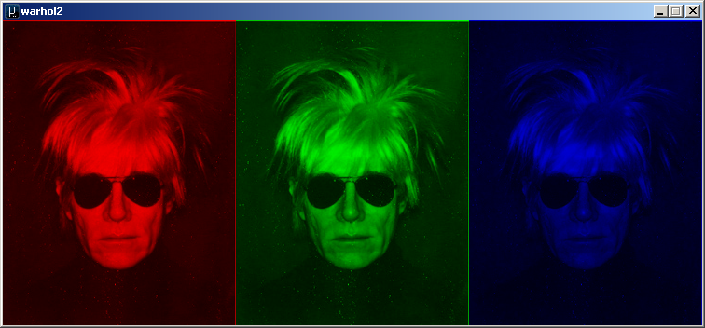
// warhol2
void setup() {
// Load the image three times
PImage warhol = loadImage("andy-warhol2.jpg");
size(warhol.width*3, warhol.height);
// Draw modified images
tint(255, 0, 0);
image(warhol, 0, 0);
tint(0, 255, 0);
image(warhol, 250, 0);
tint(0, 0, 255);
image(warhol, 500, 0);
}

Slide 19
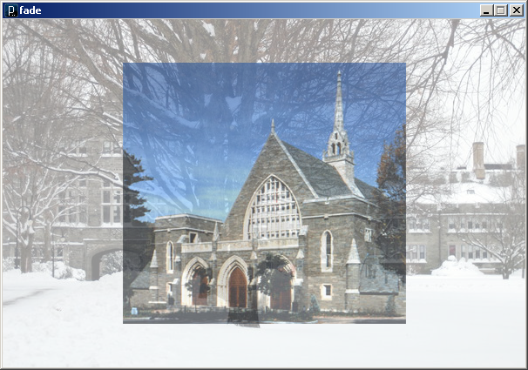
// fade
PImage[] img = new PImage[5];
int alpha = 255;
int i1 = 0, i2 = 1;
void setup() {
size(600,400);
imageMode(CENTER);
for (int i=0; i<img.length; i++) // Load images
img[i] = loadImage("bmc"+i+".jpg");
}
void draw() {
background(255);
// Fade out current image
tint(255, alpha);
image(img[i1], 300, 200);
// Fade in next image
tint(255, 255-alpha);
image(img[i2], 300, 200);
// Swap images when fade complete
alpha--;
if (alpha < 0) {
i1 = (i1 + 1) % img.length;
i2 = (i2 + 1) % img.length;
alpha = 255;
}
}

Slide 20
// pointillism
PImage img;
void setup() {
img = loadImage("bmc3.jpg");
image(img.width, img.height);
imageMode(CENTER);
image(img, width/2, height/2);
noStroke();
ellipseMode(CENTER);
loadPixels(); // Cover with random circles
for (int i=0; i<20000; i++) addPoint();
}
void addPoint() {
// Add a random filled circle to image
int x = (int)random(width);
int y = (int)random(height);
int i = x + width*y;
color c = pixels[i];
fill(c);
ellipse(x, y, 7, 7);
}
void draw() {
//addPoint();
}

Slide 21
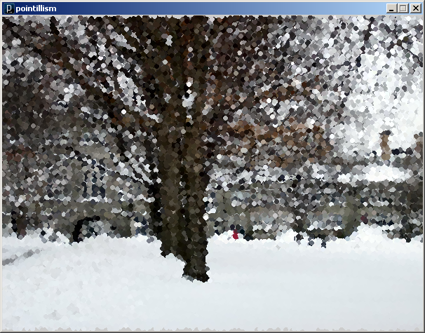

Slide 22
Simple Image Visualization
Sample pixel colors every n pixels
Draw a grid of basic shapes (ellipse, rect, line, triangle, etc) using the sampled color as fill color or stroke color

