Slide 1
Review
Images – an array of colors
Color – RGBA
Loading, modifying, updating pixels
pixels[] as a 2D array
Simple filters – tinting, grayscale, negative, sepia
PImage class, fields and methods
get() method and crumble
tint() function – color and alpha filtering
Creative image processing – Pointillism, other shapes

Slide 2
Medical Images

Slide 3
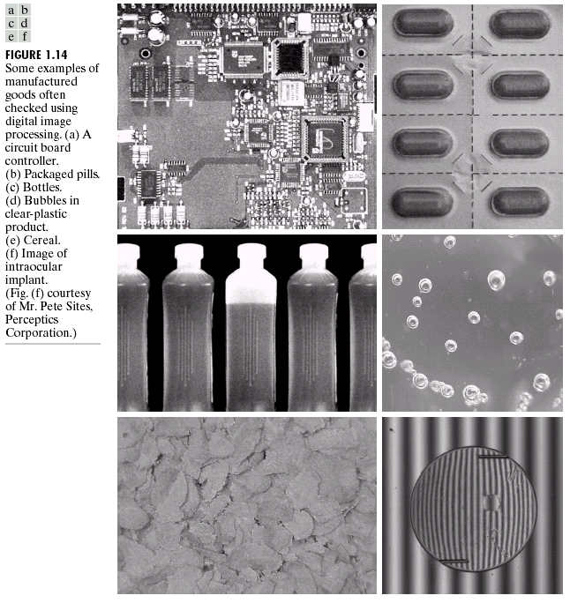
Image Processing in Manufacturing

Slide 4
What can you do with Image Processing?
Inspect, Measure, and Count using Photos and Video
http://www.youtube.com/watch?v=KsTtNWVhpgI
Image Processing Software
http://www.youtube.com/watch?v=1WJp9mGnWSM

Slide 5
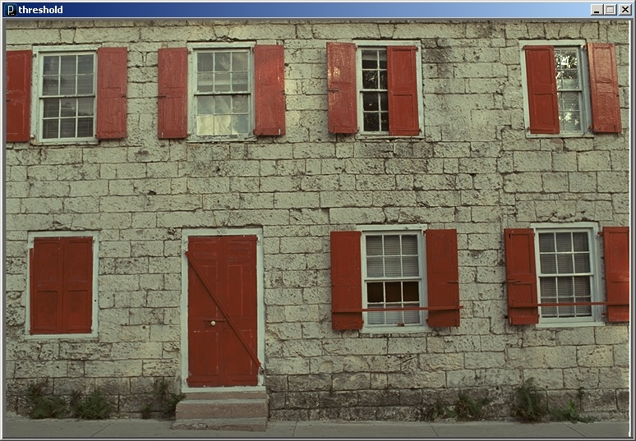
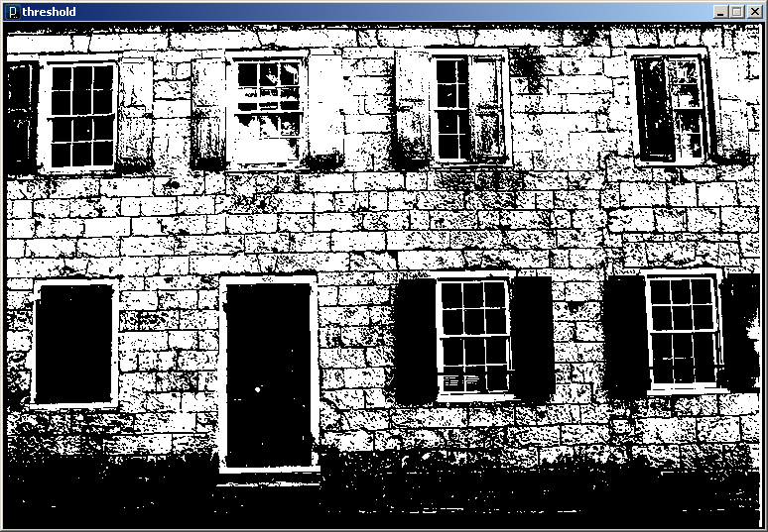
Thresholding for Image Segmentation
Pixels below a cutoff value are set to black
Pixels above a cutoff value are set to white

Slide 6
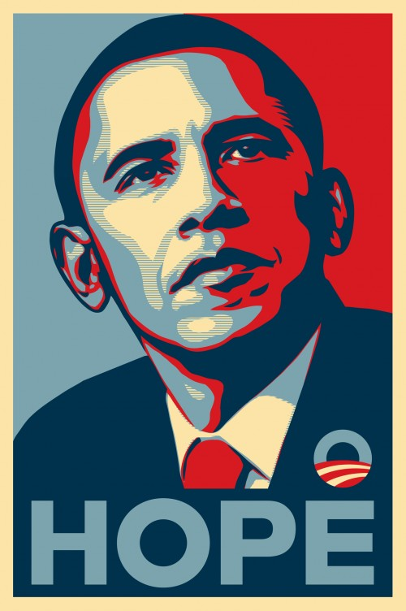
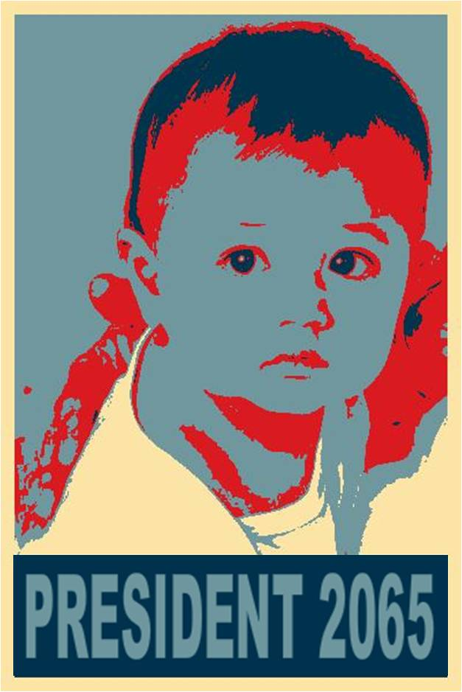
Obamicon

Slide 7
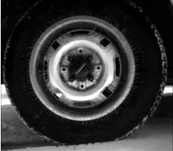
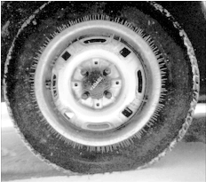
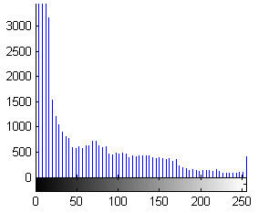
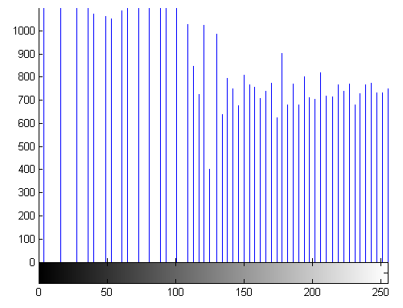
Image Enhancement
  Color and intensity adjustment
    Histogram equalization
  Kun Huang, Ohio State / Digital Image Processing using Matlab, By R.C.Gonzalez, R.E.Woods, and S.L.Eddins

Slide 8
Histogram Equalization
Increases the global contrast of images
So that intensities are better distributed
Reveals more details in photos that are over or under exposed
Better views of bone structure in X-rays

Slide 9
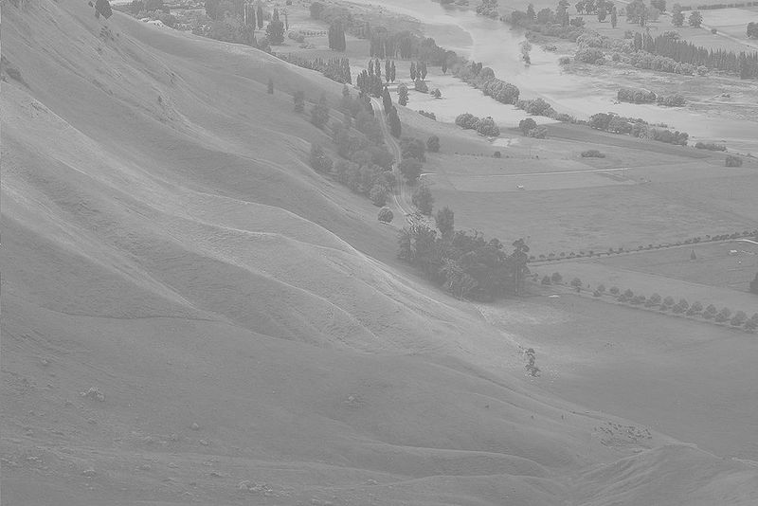
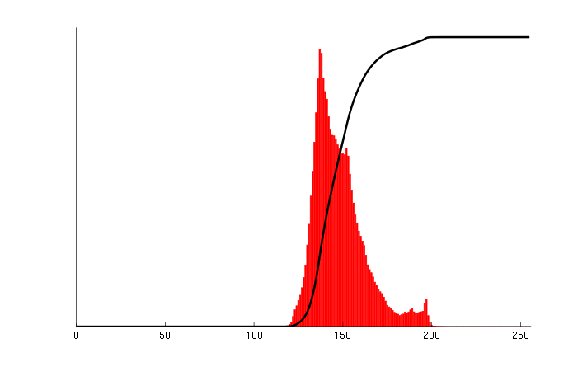
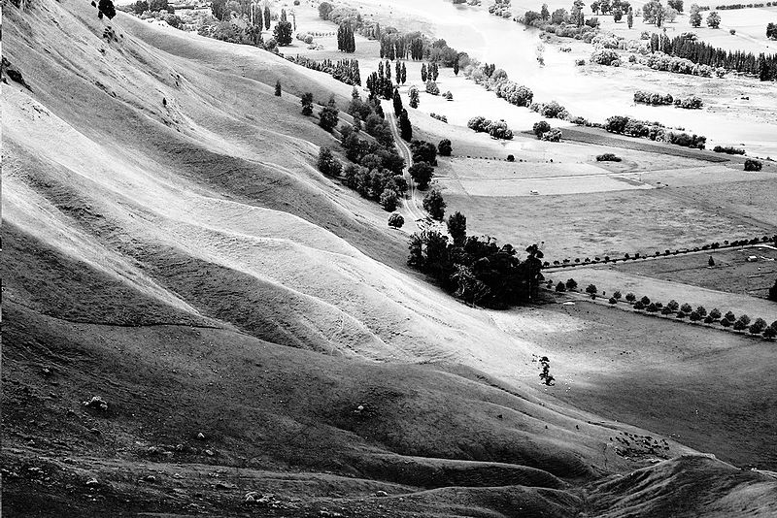
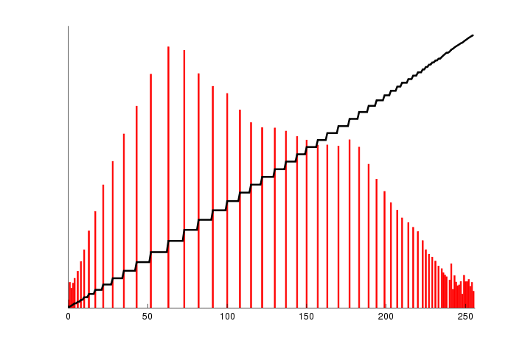

Slide 10
Histogram Equalization
Calculate color frequencies - count the number of times each pixel color appear in the image
Calculate the cumulative distribution function (cdf) for each pixel color – the number of times all smaller color values appear in the image
Normalize over (0, 255)

Slide 11
Convolution Filters (Area-based)
Input Image
Output Image
 |  |  | A | B | C
 |  |  | D | E | F
 |  |  | G | H | I
 |  |  |  | E'
w₁ | w₂ | w₃
w₄ | w₅ | w₆
w₇ | w₈ | w₉
Spatial Kernel Filter
E' = w₁A+w₂B+w₃C+w₄D+w₅E+w₆F+w₇G+w₈H+w₉I

Slide 12
Identity
No change
0 | 0 | 0
0 | 1 | 0
0 | 0 | 0

Slide 13
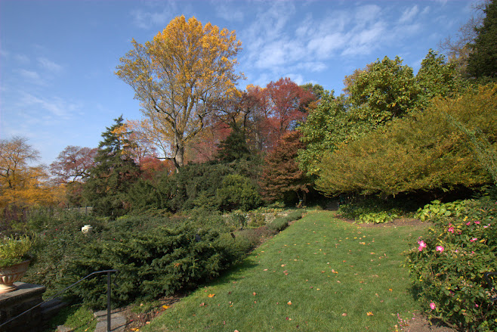
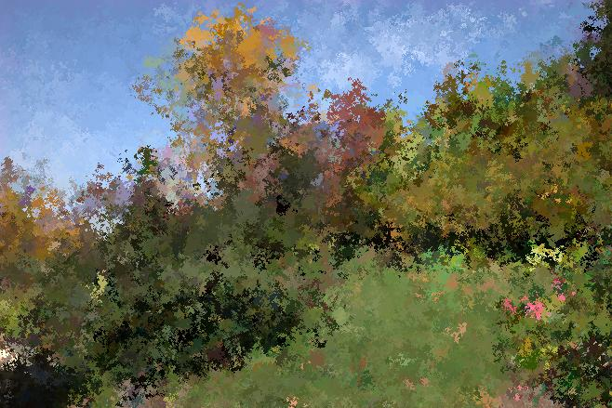
Random Neighbor
Copies randomly from one of the 8 neighbors, and itself

Slide 14
Average – smooth
Set pixel to the average of all colors in the neighborhood
Smoothes out areas of sharp changes.
1/9 | 1/9 | 1/9
1/9 | 1/9 | 1/9
1/9 | 1/9 | 1/9

Slide 15
Sharpen – High Pass Filter
Enhances the difference between neighboring pixels
The greater the difference, the more change in the current pixel
-1 | -1 | -1
-1 | 9 | -1
-1 | -1 | -1
0 | -2/3 | 0
-2/3 | 11/3 | -2/3
0 | -2/3 | 0

Slide 16
Blur – Low Pass Filter
Softens significant color changes in image
Creates intermediate colors
1/16 | 2/16 | 1/16
2/16 | 4/16 | 2/16
1/16 | 2/16 | 4/16

Slide 17
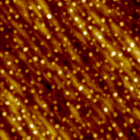
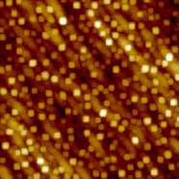
Dilation - Morphology
Set pixel to the maximum color value within a neighborhood around the pixel
Causes objects to grow in size.
Brightens and fills in small holes

Slide 18
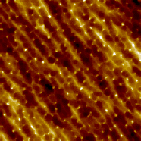
Erosion - Morphology
Set pixel to the minimum color value within a neighborhood around the pixel
Causes objects to shrink.
Darkens and removes small objects

Slide 19
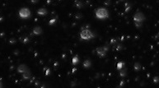
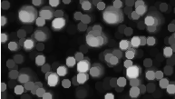
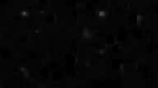
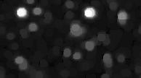
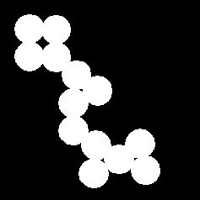

Feature Extraction – Region Detection
  Dilate and Erode
  Open
    Erode → dilate
    Removes noise
  Close
    Dilate → Erode
    Holes are closed
  Kun Huang, Ohio State / Digital Image Processing using Matlab, By R.C.Gonzalez, R.E.Woods, and S.L.Eddins

Slide 20
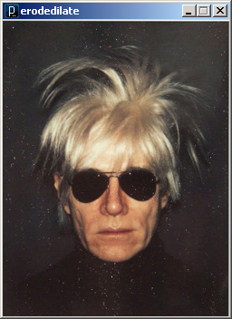
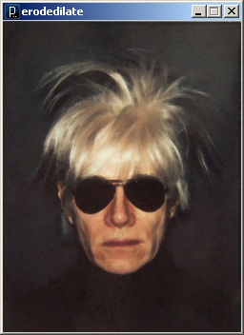
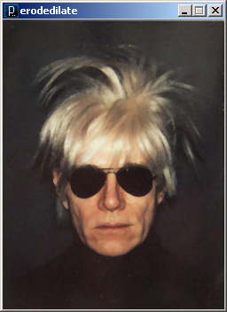
Erode + Dilate to Despeckle
Erode
Dilate

Slide 21
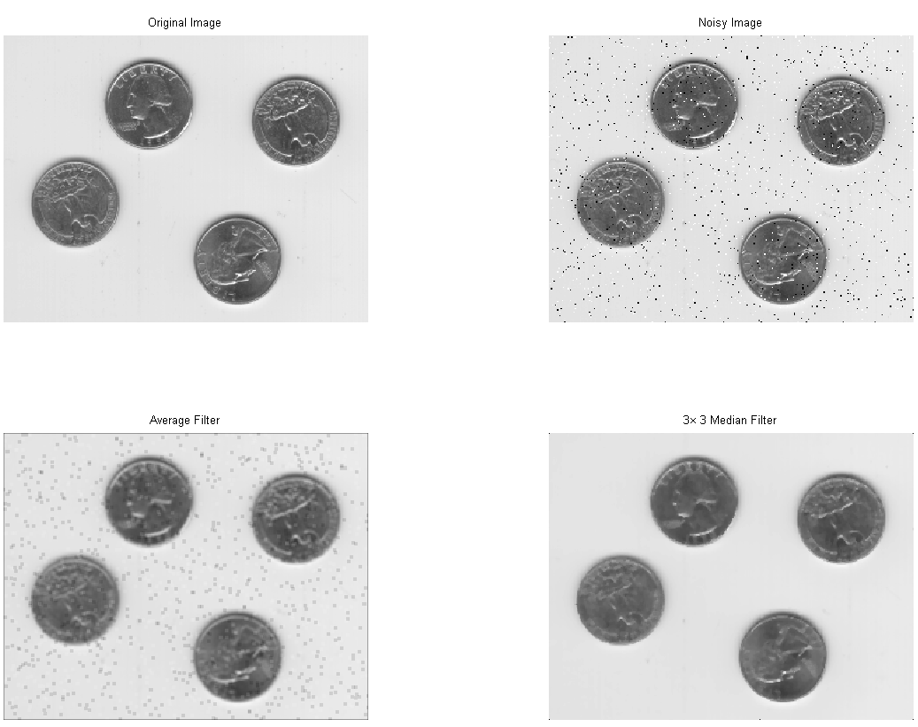
Image Enhancement
  Denoise
    Averaging
    Median filter
1/9 | 1/9 | 1/9
1/9 | 1/9 | 1/9
1/9 | 1/9 | 1/9
20 | 5 | 43
78 | 3 | 22
115 | 189 | 200
43
  Kun Huang, Ohio State / Digital Image Processing using Matlab, By R.C.Gonzalez, R.E.Woods, and S.L.Eddins

Slide 22
Image Processing in Processing
tint() modulate individual color components
blend() combine the pixels of two images in a given manner
filter() apply an image processing algorithm to an image

Slide 23
Blend Command
  img = loadImage("colony.jpg");
  mask = loadImage("mask.png");
  image(img, 0, 0);
  blend(mask, 0, 0, mask.width, mask.height,
  0, 0, img.width, img.height, SUBTRACT);
BLEND linear interpolation of colours: C = A*factor + B
ADD additive blending with white clip: C = min(A*factor + B, 255)
SUBTRACT subtractive blending with black clip: C = max(B - A*factor, 0)
DARKEST only the darkest colour succeeds: C = min(A*factor, B)
LIGHTEST only the lightest colour succeeds: C = max(A*factor, B)
DIFFERENCE subtract colors from underlying image.
EXCLUSION similar to DIFFERENCE, but less extreme.
MULTIPLY Multiply the colors, result will always be darker.
SCREEN Opposite multiply, uses inverse values of the colors.
OVERLAY A mix of MULTIPLY and SCREEN. Multiplies dark values, and screens light values.
HARD_LIGHT SCREEN when greater than 50% gray, MULTIPLY when lower.
SOFT_LIGHT Mix of DARKEST and LIGHTEST. Works like OVERLAY, but not as harsh.
DODGE Lightens light tones and increases contrast, ignores darks.
BURN Darker areas are applied, increasing contrast, ignores lights.
Draw an image and then blend with another image

Slide 24
Filter Command
  PImage b;
  b = loadImage("myImage.jpg");
  image(b, 0, 0);
  filter(THRESHOLD, 0.5);
THRESHOLD converts the image to black and white pixels depending if they are above or below the threshold defined by the level parameter. The level must be between 0.0 (black) and 1.0(white). If no level is specified, 0.5 is used.
GRAY converts any colors in the image to grayscale equivalents
INVERT sets each pixel to its inverse value
POSTERIZE limits each channel of the image to the number of colors specified as the level parameter
BLUR executes a Gaussian blur with the level parameter specifying the extent of the blurring. If no level parameter is used, the blur is equivalent to Gaussian blur of radius 1.
OPAQUE sets the alpha channel to entirely opaque.
ERODE reduces the light areas with the amount defined by the level parameter.
DILATE increases the light areas with the amount defined by the level parameter.
Draw an image and then apply a filter

Slide 25
// Threshold
PImage img;
void setup() {
img = loadImage("kodim01.png");
size(img.width, img.height);
image(img, 0, 0);
}
void draw() {}
void drawImg(float thresh) {
image(img, 0, 0);
filter(THRESHOLD, thresh);
}
void mouseDragged() {
float thresh = map(mouseY, 0, height, 0.0, 1.0);
println(thresh);
drawImg(thresh);
}

Slide 26
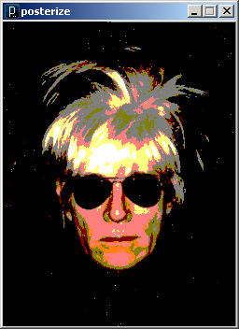
// Posterize
PImage img;
void setup() {
img = loadImage("andy-warhol2.jpg");
size(img.width, img.height);
image(img, 0, 0);
}
void draw() {}
void drawImg(float val {
image(img, 0, 0);
filter(POSTERIZE, val);
}
void mouseDragged() {
float val = int(map(mouseY, 0, height, 2, 10));
val = constrain(val, 2, 10);
println(val);
drawImg(val);
}

Slide 27
Image Processing Applications
Manual Colony Counter
http://www.youtube.com/watch?v=7B-9Wf6pENQ
Automated Colony counter
http://www.youtube.com/watch?v=qtJmQqRHHag

Slide 28
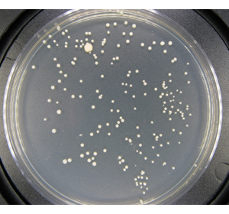
Measuring Confluency in Cell Culture Biology
Refers to the coverage of a dish or flask by the cells
100% confluency = completely covered
Image Processing Method
  Mask off unimportant parts of image
  Threshold image
  Count pixels of certain color

Slide 29
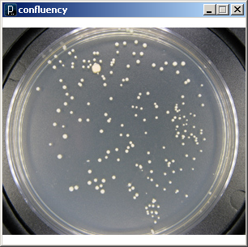
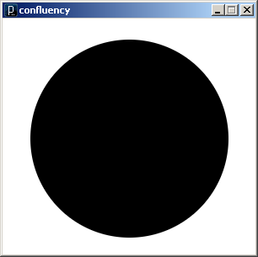
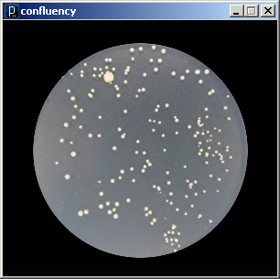
Blend: Subtract
Original
Mask
Subtracted

Slide 30
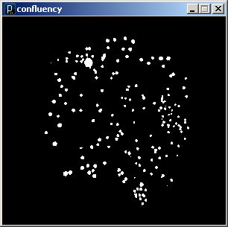
Filter: Theshold
Subtracted
Threshold
Count pixels to quantitate: 5.3% confluency

Slide 31

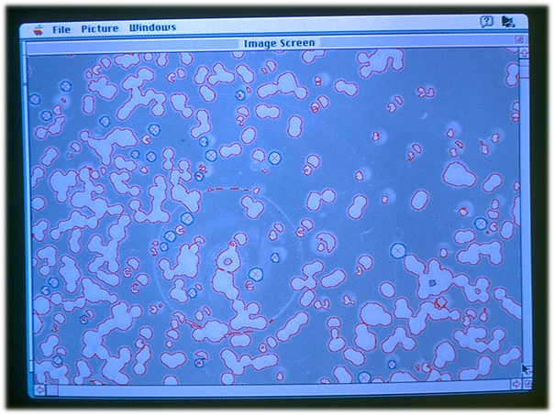
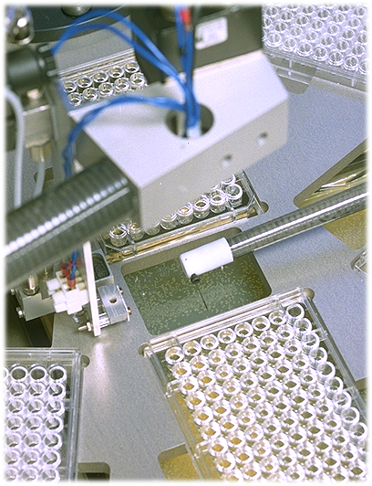
Vision Guided Robotics
Colony Picking
Camera
Robot
Arm

Slide 32
Predator algorithm for object tracking with learning
http://www.youtube.com/watch?v=1GhNXHCQGsM
Video Processing, with Processing
http://www.niklasroy.com/project/88/my-little-piece-of-privacy/
http://www.youtube.com/watch?v=rKhbUjVyKIc

