Slide 1
Fonts
PFont.list();
Returns a String array of available font names
println( PFont.list() );
createFont( name, size );
createFont( name, size, smooth );
Returns a PFont object to be used by Processing
textFont( font )
textFont( font, size );
Sets the current font
textAscent() / textDescent();
Returns height of current font above / below baseline
textWidth( string )
Returns the width of a string using the current font

Slide 2
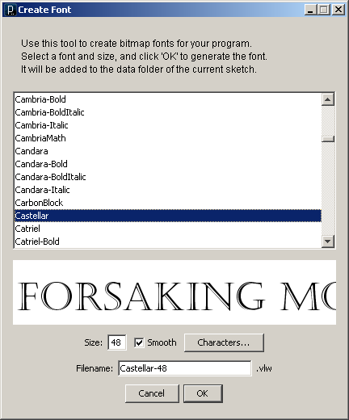
Create Font Utility
Load created font files into a PFont object using…
loadFont( filename );

Slide 3
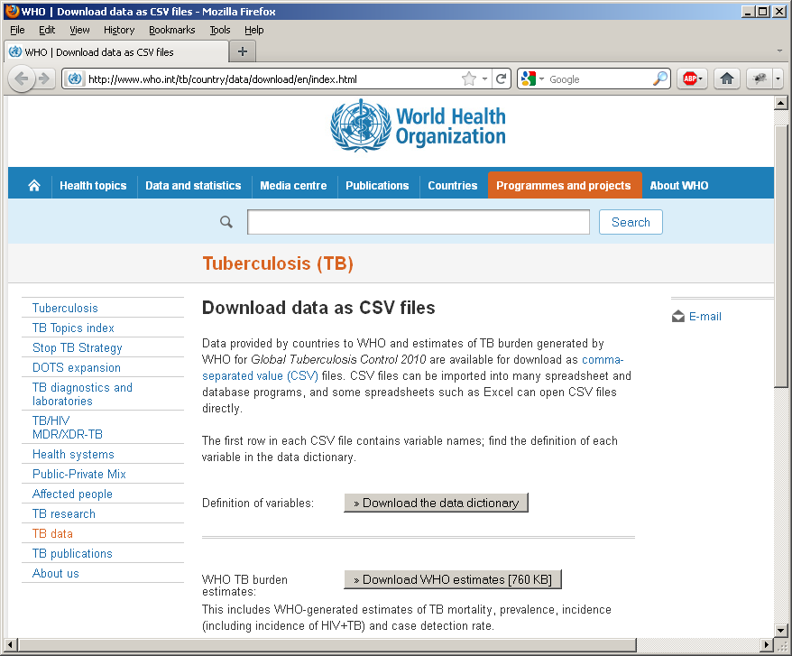
WHO Tuberculosis Data
http://www.who.int/tb/country/data/download/en/index.html

Slide 4
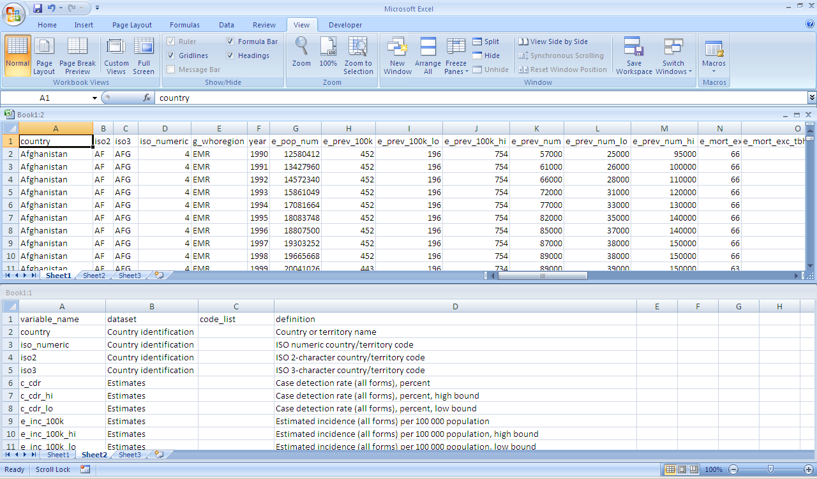
Notes:
Get data from Internet
Google Tuberculosis data
Found data from WHO
Study data
Data dictionary
Data set
Loaded into Excel and processed
limited to that of interest
Sorted by year and country
Loaded into Processing using loadStrings
Converted to an array of Objects
Changed blanks to -1

Slide 5
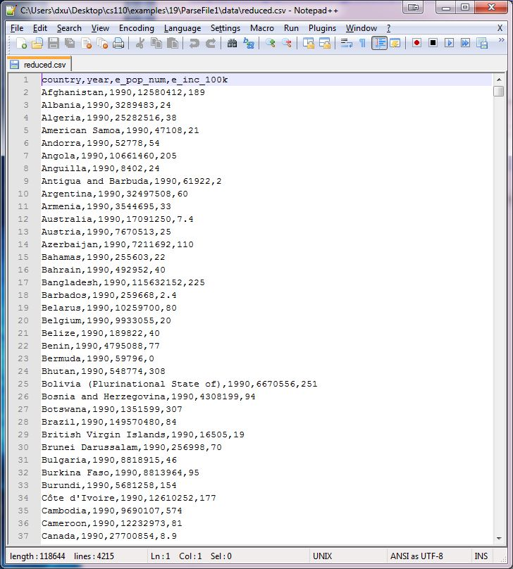

Slide 6
// ParseFile1
String[] data;
int count = 0;
void setup() {
// Load data from a file as array of strings
data = loadStrings("reduced.csv");
}
void draw() {
// Continue printing data until run out
if (count >= data.length) return;
println(data[count]);
count++;
}

Slide 7
// ParseFile2
String[] data;
Item[] items;
int count = 0;
void setup() {
// Load data as array of strings
data = loadStrings("reduced.csv");
// Build object array
items = new Item[data.length];
for (int i=0; i<data.length; i++) {
items[i] = new Item(data[i]);
}
}
void draw() {
// Continue printing data until run out
if (count >= items.length) return;
items[count].pr();
count++;
}
class Item {
String country; // Country name
int year; // Year
int pop; // Population
int inc; // Incidences of TB
// per 100,000
Item(String line) {
String[] data = line.split(",");
country = data[0];
year = int(data[1]);
pop = int(data[2]);
inc = int(data[3]);
}
void pr() {
String msg = "In " + year + ", " + country;
msg += " had population " + pop;
msg += " and TB incidences per 100k of " + inc;
println(msg);
} }
}

Slide 8
Data Sources
http://www.data.gov/
http://archive.ics.uci.edu/ml/
http://opendata.socrata.com/
http://www.reddit.com/r/datasets
http://www.quora.com/Data/Where-can-I-get-large-datasets-open-to-the-public
http://www.readwriteweb.com/archives/where_to_find_open_data_on_the.php
http://www.visual-literacy.org/periodic_table/periodic_table.html
Data Source Lists
Ideas for Visualizations

Slide 9
GapMinder
http://www.gapminder.org
http://www.gapminder.org/videos/hans-rosling-on-cnn-us-in-a-converging-world/
Hans Roesling
Karolinska Institutet
Stockholm, Sweden

Slide 10
Map of Science

Slide 11
Flavors and Their Chemical Relationships

Slide 12
Transportation Check-ins

Slide 13
Corruption and Human Development

Slide 14
Every death on every road

Slide 15
Who owes how much to whom?

