Slide 1
Data Visualization
Graphical representation of information
Chars
Plots
Maps
Time series

Slide 2
Data Visualization Process
Acquire - Obtain the data from some source
Parse - Give the data some structure, clean up
Filter - Remove all but the data of interest
Mine - Use the data to derive interesting properties
Statistical methods
Pattern recognition
Numerical analysis, etc

Slide 3
Data Visualization Process
Represent - Chose a visual representation
Refine – Improve to make it more visually engaging
Interact - Make it interactive
manipulating the data
controlling visual features, etc.

Slide 5
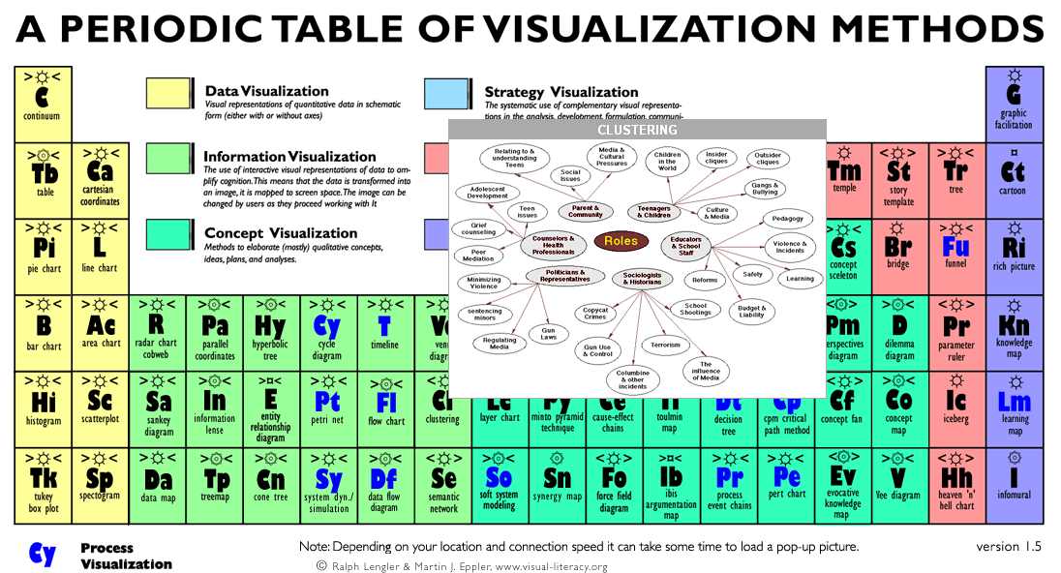
http://www.visual-literacy.org/periodic_table/periodic_table.html

Slide 6
Jer Thorp. Artist/Educator - NYU
225 "random" numbers chosen and tweeted by 225 people
19 | 42 | 42 | 87 | 81 | 99 | 33 | 98 | 61 | 47 | 24 | 66
69 | 23 | 67 | 67 | 57 | 71 | 5 | 79 | 57 | 46 | 93 | 54
43 | 32 | 18 | 42 | 77 | 37 | 37 | 6 | 93 | 55 | 55 | 77
15 | 88 | 42 | 55 | 77 | 42 | 93 | 3 | 17 | 26 | 64 | 65
23 | 21 | 9 | 7 | 23 | 17 | 14 | 42 | 45 | 27 | 97 | 83
89 | 4 | 4 | 26 | 6 | 39 | 97 | 72 | 35 | 6 | 66
19 | 2 | 72 | 81 | 37 | 47 | 66 | 17 | 12 | 52 | 74
54 | 61 | 43 | 19 | 57 | 17 | 77 | 47 | 26 | 72 | 64
69 | 99 | 64 | 88 | 67 | 1 | 36 | 2 | 60 | 27 | 73
4 | 43 | 97 | 67 | 42 | 37 | 27 | 1 | 75 | 15 | 17
13 | 59 | 32 | 78 | 40 | 15 | 64 | 77 | 11 | 1 | 17
37 | 13 | 7 | 26 | 57 | 25 | 12 | 69 | 8 | 84 | 23
66 | 42 | 14 | 33 | 17 | 97 | 25 | 57 | 1 | 81 | 97
8 | 18 | 78 | 12 | 95 | 37 | 84 | 86 | 41 | 56 | 73
78 | 60 | 21 | 39 | 28 | 17 | 83 | 69 | 12 | 74 | 37
67 | 19 | 19 | 88 | 96 | 69 | 29 | 74 | 53 | 33 | 72
32 | 81 | 72 | 72 | 73 | 39 | 52 | 97 | 77 | 77 | 41
76 | 17 | 69 | 83 | 67 | 64 | 25 | 35 | 42 | 4 | 76
13 | 36 | 2 | 37 | 52 | 47 | 43 | 25 | 66 | 7 | 6
87 | 94 | 16 | 28 | 20 | 79 | 23 | 21 | 55 | 66 | 87
http://blog.blprnt.com/blog/blprnt/your-random-numbers-getting-started-with-processing-and-data-visualization

