Slide 1
Review
Data Visualization Process

Slide 2
Text Analysis/Text Mining
Derive high-quality information on patterns and trends in the text via statistical pattern learning
Word frequency analysis
Sentiment analysis
Text categorization
Text clustering
Related fields
Computational Linguistics
Natural Language Processing
Information Retrieval
Machine Learning
Artificial Intelligence

Slide 3
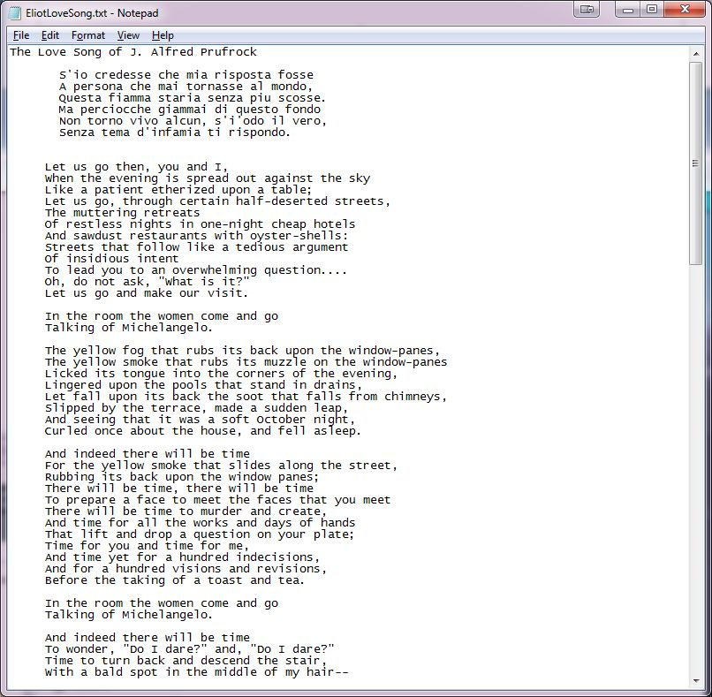
Acquire

Slide 4
Parse and Filter
String raw;
String delimiters = " ,.?!;:-\'\"()*![]{}|\\~`@#$%^&";
String[] fileText, words;
int[] freqs;
void setup() {
fileText = loadStrings("EliotLoveSong.txt");
println("Read " + fileText.length + " lines.");
raw = join(fileText, " ");
raw = raw.toLowerCase();
words = splitTokens(raw, delimiters);
println("Found " + words.length + " words.");
}

Slide 5
Mine
String raw;
String delimiters = " ,.?!;:-\'\"()*![]{}|\\~`@#$%^&";
String[] fileText, words, uniqueWords;
int[] freqs;
void setup() {
fileText = loadStrings("EliotLoveSong.txt");
println("Read " + fileText.length + " lines.");
raw = join(fileText, " ");
raw = raw.toLowerCase();
words = splitTokens(raw, delimiters);
println("Found " + words.length + " words.");
freqs = makeUnique(words);
println("Found "+uniqueWords.length+" unique words.");
}

Slide 7
Data Structures
Ways of storing and organizing data
Arrays
Must know the size ahead of time
Can not grow and shrink at will

Slide 8
Built-in Collection Classes
ArrayList
A built-in object that stores and manages an arbitrary number of data items of any type (Objects).
Objects in an ArrayList are accessed by index [0..size-1]
HashMap
A built-in object that stores and manages an arbitrary number of data items of any type (Objects).
Objects in a HashMap are accessed by a key, which can be another Object, frequently a String.

Slide 9
ArrayList
Constructors
ArrayList lst1 = new ArrayList();
ArrayList lst2 = new ArrayList(int initialSize);
Fields
Methods
size() // Returns the num of items held.
add(Object o) // Appends o to end.
add(int idx, Object o) // Inserts o at pos idx.
remove(int idx) // Removes item at pos idx.
get(int idx) // Gets items at idx. No removal.
set(int idx, Object o) // Replaces item at idx with o.
clear() // Removes all items.
isEmpty() // true if empty.
toArray() // returns an array that contains
// the contents of the list

Slide 10
ArrayList Example – Box Dropper
// Box Dropper
ArrayList boxes = new ArrayList();
void setup() { size(500, 500); }
void draw() {
background(0);
for (int i = boxes.size()-1; i>=0; i--) {
//boxes.get(i).draw(); // Fails. Why?
Box b = (Box)boxes.get(i); // Type cast Object->Box
if(b.update()) {
boxes.remove(i);
println(boxes.size() + " boxes remaining");
}
else {
b.draw();
}
}
}
void mousePressed() {
Box b = new Box(mouseX, mouseY);
boxes.add(b);
println( boxes.size() + " boxes in ArrayList" );
}
// A simple Box class
class Box {
float x, y, v;
Box(float tx, float ty) {
x = tx; // x position
y = ty; // y position
v = 0.0; // y velocity
}
void draw() {
fill(200);
rect(x, y, 20, 20);
}
boolean update(){
y += v;
v += 0.02;
return (y>height);
}
}
Why can we not call draw directly on item in ArrayList?
Why do we loop over ArrayList backwards?

Slide 11
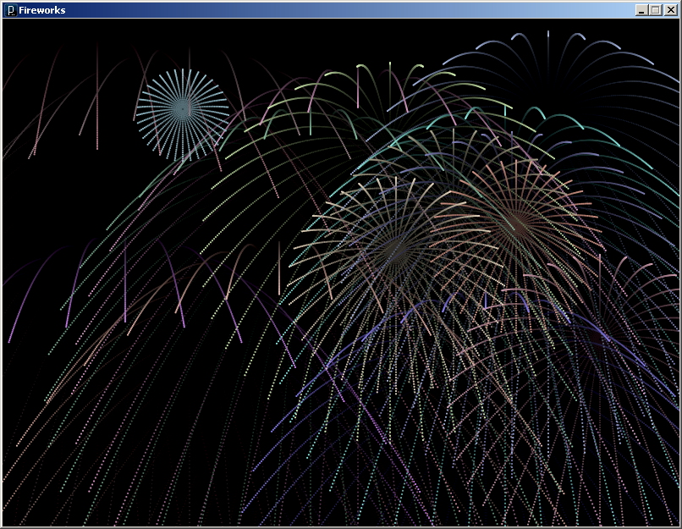
ArrayList Example - Fireworks

Slide 12
HashMap
Constructors
HashMap map1 = new HashMap();
HashMap map2 = new HashMap(int initialCapacity);
Fields
Methods
size() // Returns num of items held.
put(Object key, Object o) // Puts o in map at key
remove(Object key) // Remove Object at key
get(Object key) // Get Object at key
containsKey(Object key) // True if map contains key
containsValue(Object val) // True if map contains val
clear() // Removes all items.
isEmpty() // true if empty.

Slide 13
HashMap Example – High Score
// HighScore
HashMap scores = new HashMap();
void setup() {
size(500, 500);
// Init HashMap
scores.put("Fred", 2);
scores.put("Wilma", 4);
scores.put("Barney", 10);
scores.put("Betty", 5);
scores.put("BamBam", 6);
scores.put("Pebbles", 5);
// Draw once
noLoop();
drawMap(scores);
}
void draw() { }
// Draw the HashMap to the sketch
void drawMap(HashMap hm) {
background(0);
fill(255);
textSize(20);
// Display all scores
text( buildScore("Fred", scores), 100, 100);
text( buildScore("Wilma", scores), 100, 150);
text( buildScore("Barney", scores), 100, 200);
text( buildScore("Betty", scores), 100, 250);
text( buildScore("BamBam", scores), 100, 300);
text( buildScore("Pebbles", scores), 100, 350);
redraw();
}
// Build a return a String for displaying a Score
String buildScore(String name, HashMap hm) {
String msg = name + ":" + hm.get(name).toString();
return msg;
}

Slide 14
Sorting
Any process of arranging items in sequence
Build-in sort()
Works on arrays of simple types, i.e. int, float and String
float[] a = { 3.4, 3.6, 2, 0, 7.1 };
a = sort(a);
String[] s = { "deer", "elephant", "bear", "aardvark", "cat" };
s = sort(s, 3);
Convenient, but not very flexible

Slide 15
Implement your own sort
Many sorting algorithms
Bubble Sort
Looks at items in successive pairs
Swap if in the wrong order
Selection Sort
Scan a list top to bottom and find the value that should come first
Swap that item with the top position
Repeat scan starting at next lowest item in the list
Works best when swapping is expensive

Slide 16
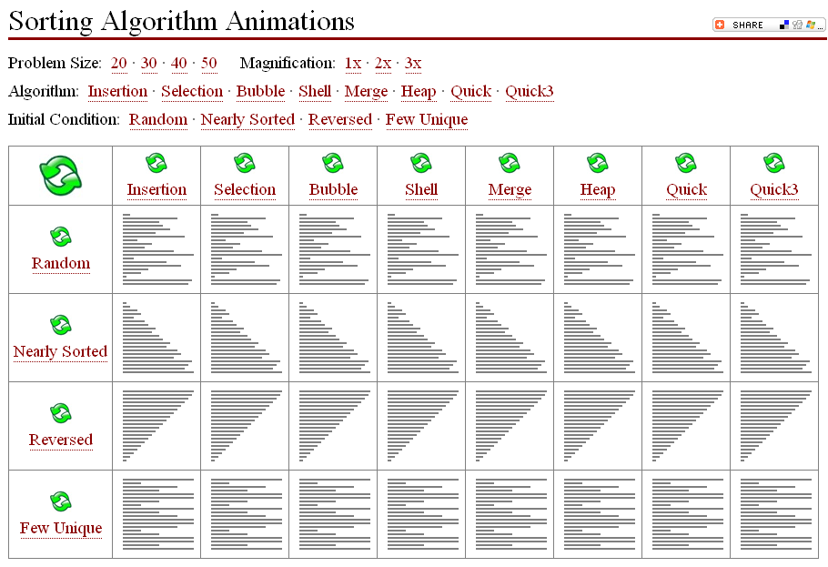
Comparing Sorting Algorithms
http://www.sorting-algorithms.com/

