Slide 1
Processing == Java + Extra Utilities
Processing Adds:
Drawing functions
Text and font manipulations
Image and video
3D transformations
Keyboard interaction
An editor
…

Slide 2
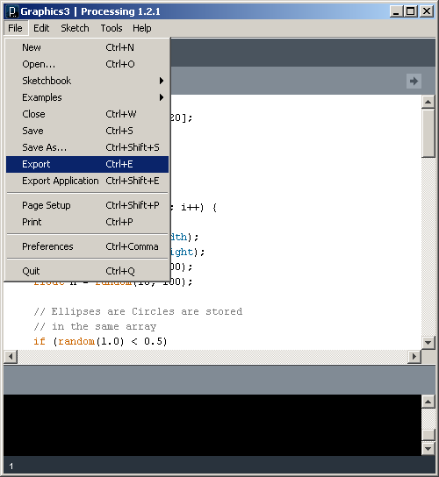
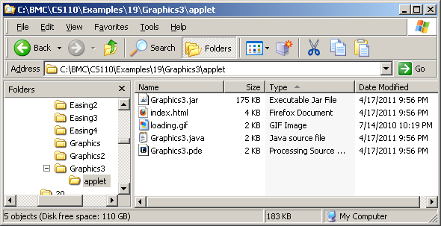
Best way to see what Processing becomes is to generate a Java program and compare
File | Export
Look in generated applet folder

Slide 3
What's different?
Import of core Processing libraries
Import of numerous Java libraries
Encapsulation of code in subclass of PApplet
Explicit visibility – public, private …
Number format changes
if (random(1.0) < 0.5) -> if (random(1.0f) < 0.5f)
color data types are converted to int
Some functions are changed
numbers = int(snumbers); ->
numbers = PApplet.parseInt(snumbers);
Added public static void main() {…

Slide 4
The smallest program in Processing
println("Hello World!");
The equivalent program in Java.
class HelloWorldApp {
public static void main(String[] args) {
// Display the string.
System.out.println("Hello World!");
}
}
All Java programs start with at the special function …
public static void main() { …
This must be added to the generated Java program

Slide 5
PApplet
The top-level class in Processing
The class in which all your Processing code goes
Implements most of Processing's core behavior
Way down the Java hierarchy
java.lang.Object
↘ java.awt.Component
↘ java.awt.Container
↘ java.awt.Panel
↘ java.applet.Applet
↘ processing.core.PApplet
http://processing.googlecode.com/svn/trunk/processing/build/javadoc/core/processing/core/PApplet.html

Slide 6
Nearly all of Java is available from Processing
http://download.oracle.com/javase/6/docs/api/

