Slide 1
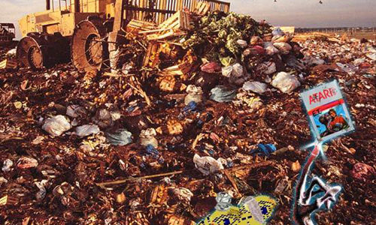
Great Video Game Crash of 1983

Slide 2
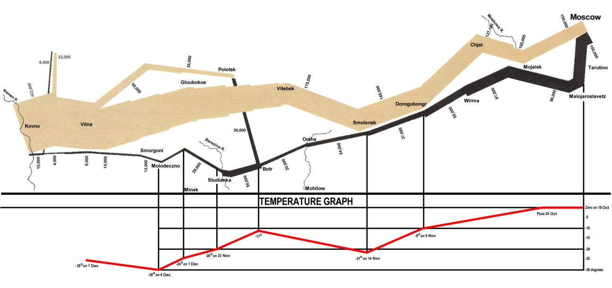
Napoleon’s Russian Campaign, 1812-1813

Slide 3
The dumpster

Slide 4
Exam 2 Review Objects, Inheritance, Arrays, Strings

Slide 5
Objects
Defined by template given in as class statement.
An object is created by invoking the class's constructor using the new keyword.
An objects is stored in a variable declared with class as type
Values passed to a constructor must be copied to object fields to "stick”

Slide 6
Tree myMaple; // Variable defined as type Tree
void setup() {
myMaple = new Tree("maple", 30.3); // Create
}
class Tree {
String name;
float height;
Tree( String tname, float theight) {
name = tname;
height = theight;
}
void draw() {
fill( 0, 255, 0 );
ellipse(random(width),random(height),50,50);
}
}
fields
constructor
method

Slide 7
Creating Objects
Declare a variable with the class as type
Invoke the constructor using the new keyword and assign to variable
Tree myMaple; // Variable defined as type Tree
myMaple = new Tree("maple", 30.3); // Create and assign
// -----
// Two steps combined in one
Tree myMaple = new Tree("maple", 30.3);

Slide 8
Creating Objects
What is wrong with this?
Tree myMaple; // Variable defined as type Tree
void setup() {
Tree myMaple = new Tree("maple", 30.3); // Combined
}

Slide 9
Using Objects
variable :: fields (variable inside an object)
function :: method (function inside an object)
An variable that stores an object is used to scope access to the fields and methods of that particular object

Slide 10
Tree myMaple;
void setup() {
myMaple = new Tree("maple", 30.3);
}
void draw() {
myMaple.draw();
}
class Tree {
String name;
float height;
Tree( String tname, float theight) {
name = tname;
height = theight;
}
void draw() {
fill( 0, 255, 0 );
rect( 10, 10, 50, 300 );
}
}
Using Objects

Slide 11
Tree myMaple;
void setup() {
myMaple = new Tree("maple", 30.3);
}
void draw() {
Tree.draw();
}
class Tree {
String name;
float height;
Tree( String tname, float theight) {
name = tname;
height = theight;
}
void draw() {
fill( 0, 255, 0 );
rect( 10, 10, 50, 300 );
}
}
Using Objects
What is wrong with this?

Slide 12
Inheritance
Superclass (base class) – higher in the hierarchy
Subclass (child class) – lower in the hierarchy
A subclass is derived from from a superclass
Subclasses inherit all the fields and methods of their superclass
Subclasses can override a superclass method by redefining it.
They can replace anything by redefining locally

Slide 13
class Person {
String name; int age;
Person(String name, int age) {
this.name = name;
this.age = age;
}
void pr() {
println(name + " is " + age + " years old.");
}
void stats() {}
}
class Student extends Person {
int year; float GPA;
Student(String name, int year, float GPA) {
super(name, 18);
this.year = year;
this.GPA = GPA;
}
void stats() {
println(name + " will graduate in " + year);
}
}

Slide 14
class Employee extends Person {
float salary; String position; boolean current;
Employee(String name, int age) {
super(name, age);
}
void hire(String position, float salary) {
this.position = position;
this.salary = salary;
current = true;
}
void fire() {
current = false;
}
void stats() {
if (current) {
println(name + " works as " + position + " making " + salary);
}
else {
println(name + " is not working for us.");
}
}
}

Slide 15
Arrays - Creating
A structure that can hold multiple items of a common data type
Arrays can hold any data type, including objects
The data type to be held by an array must be declared as part of the array declaration
Arrays are themselves a kind of type, which is made by adding brackets to the type that the array can hold

Slide 16
Arrays – Creating and Init'ng (3 Steps)
Declare an array variable
The variable is NOT an array
Create an array and assign it to the variable
Use the new keyword and size
The array is filled with default values
int <- 0
float <- 0.0
boolean <- false;
any object including String <- null
Fill the array with items of appropriate type

Slide 17
Tree[] trees;
Step 1
trees
⬅ No array. Only a variable that can hold an array.

Slide 18
Tree[] trees;
trees = new Tree[5];
Step 2
trees
null
⬅ An empty array. null Tree objects.
0
null
1
null
2
null
3
null
4

Slide 19
Tree[] trees;
trees = new Tree[5];
trees[0] = new Tree("maple", 20.0);
trees[1] = new Tree("oak", 203.4);
Step 3
trees
name="maple";
height=20.0;
⬅ An array with two Tree objects.
0
name="oak";
height=203.4;
1
null
2
null
3
null
4

Slide 20
Tree[] trees;
trees = new Tree[5];
for (int i=0; i<5; i++) {
trees[i] = new Tree( "maple"+i, random(200.0) );
}
Step 3
trees
name="maple0";
height=12.5;
⬅ An array with five Tree objects.
0
name="maple1";
height=105.3;
1
name="maple2";
height=198.6;
2
name="maple3";
height=4.08;
3
name="maple4";
height=99.9;
4

Slide 21
int[] ages;
Step 1
ages
⬅ No array. Only a variable that can hold an array.

Slide 22
int[] ages;
ages = new int[5];
Step 2
ages
0
⬅ An empty array. Default ints (0).
0
0
1
0
2
0
3
0
4

Slide 23
int[] ages;
ages = new int[5];
for (int i=0; i<5; i++) {
ages[i] = 10 + 2*i;
}
Step 3
ages
10
⬅ An array with five integers.
0
12
1
14
2
16
3
18
4

Slide 24
int[] ages = new int[5];
// Same as
// int[] ages;
// ages = new int[5];
Step 1+2
ages
0
⬅ An empty array. Default ints (0).
0
0
1
0
2
0
3
0
4

Slide 25
int[] ages = new int[] {10, 12, 14, 16, 18};
// Same as
// int[] ages = new int[5];
// for (int i=0; i<5; i++) { ages[i] = 10 + 2*i; }
Step 1+2+3
ages
10
⬅ An array with five integers.
0
12
1
14
2
16
3
18
4

Slide 26
Arrays – Using
An item in an array is accessed by following an array variable with square brackets containing the item number (index)
Array indexes start with 0
Once accessed with brackets, the result can be used as if it was the item at the location in the array

Slide 27
Person[] people;
void setup() {
people = new Person[3];
people[0] = new Person("Regis Philbin", 81);
people[1] = new Student("Mia Adams", 2015);
Employee rs = new Employee("Ryan Seacrest", 37);
rs.hire("American Idol Host", 1000000.0);
people[2] = rs;
for (int i=0; i<people.length; i++ ) {
people[i].pr();
people[i].stats();
}
}

Slide 28
Arrays of arrays (2D Arrays)
If an array can be made of any type by adding brackets, and …
an array is a kind of type, then …
an array of arrays should be possible by adding a second set of brackets
boolean[] cell1; // A variable that holds an array of booleans
boolean[][] cell2; // A variable that holds an array of
// boolean arrays

Slide 29
boolean[] cell1;
cell1 = new boolean[5];
cell1
false
⬅ One-dimensional array
0
false
1
false
2
false
3
false
4

Slide 30
boolean[][] cell2;
cell2 = new boolean[5][5];
cell2
0
1
2
3
4
⬅ Two-dimensional array
… an array of arrays
0
false
false
false
false
false
0
1
2
3
4
1
false
false
false
false
false
0
1
2
3
4
2
false
false
false
false
false
0
1
2
3
4
3
false
false
false
false
false
0
1
2
3
4
4
false
false
false
false
false

Slide 31
boolean[][] cell2;
cell2 = new boolean[5][5];
cell2[1][2] = true;
cell2
0
1
2
3
4
false
false
false
false
false
0
false
false
true
false
false
1
false
false
false
false
false
2
false
false
false
false
false
3
false
false
false
false
false
4

Slide 32
Proving a 2D array is an array of arrays
Access fields and methods of top-level array
void setup() {
boolean[][] cell2;
cell2 = new boolean[5][5]; // Create array of arrays
println( cell2[0].length ); // Access array
cell2[1][2] = true; // Access array in array
println( cell2[1] ); // Access array
}
5
[0] false
[1] false
[2] true
[3] false
[4] false

Slide 33
Proving a 2D array is an array of arrays
Build a "ragged array"
void setup() {
boolean[][] cell2;
cell2 = new boolean[5][];
cell2[0] = new boolean[2];
cell2[1] = new boolean[4];
cell2[2] = new boolean[1];
println("---");
println(cell2[0]);
println("---");
println(cell2[1]);
println("---");
println(cell2[2]);
println("---");
println(cell2[3]);
println("---");
println(cell2[4]);
}
---
[0] false
[1] false
---
[0] false
[1] false
[2] false
[3] false
---
[0] false
---
null
---
null

Slide 34
Making Strings
Declaring String objects with no chars
String myName;
String myName = new String();
Declaring String objects init'd w/ char array
String myName = "Fred";
String myName = new String("Fred");

Slide 35
String class methods
charAt(index)
Returns the character at the specified index
equals(anotherString)
Compares a string to a specified object
equalsIgnoreCase(anotherString)
S/A ignoring case (i.e. 'A' == 'a')
indexOf(char)
Returns the index value of the first occurrence of a character within the input string
length()
Returns the number of characters in the input string
substring(startIndex, endIndex)
Returns a new string that is part of the input string
toLowerCase()
Converts all the characters to lower case
toUpperCase()
Converts all the characters to upper case
concat(anotherString)
Concatenates String with anotherString
http://docs.oracle.com/javase/7/docs/api/

Slide 36
Built-in String functions (not methods)
split( bigString, splitChar)
Breaks a String into a String Array, splitting on splitChar
Returns new String Array
splitTokens( bigString, splitCharString )
Breaks a String into a String Array, splitting on any char in splitCharString
join( stringArray, joinChar )
Builds a new String by concatenating all Strings in stringArray, placing joinChar between each
Inverse of split() function
text( theString, x, y )
text( theString, x, y, width, height )
Draws theString on the sketch at (x, y)

Slide 37
Given the commands:
String aPalindrome = "a man, a plan, a canal Panama";
String[] strs = splitTokens(aPalindrome, ",");
Answer the following questions:
(3 pts) What will be the length of strs?
a) 1
b) 2
c) 3
d) 4
(3 pts) What will be the value of strs[1]?
a) "a man"
b) "a plan"
c) "a canal Panama"
d) 3
(3 pts) Write the expression used to obtain the number of elements in strs.

Slide 38
The following program was designed to count and print the number of duplicates in the myArray String array. Unfortunately, it doesn’t work properly. When I test it with the given data, it tells me that I have 11 duplicates, but I know that there are only two. Fix the program so that it works correctly.
// Count and print the number of duplicate strings in myArray
String [] myArray = {"A", "B", "C", "D", "A", "F", "C"};
void setup() {
int count = 0;
for (int i=0; i<myArray.length; i++) {
for (int j=0; j<myArray.length; j++) {
if (myArray[i].equals( myArray[j] )) {
count++;
}
}
}
println("There are " + count + " duplicates.");
}

