Slide 1
The following program was designed to count and print the number of duplicates in the myArray String array. Unfortunately, it doesn’t work properly. When I test it with the given data, it tells me that I have 11 duplicates, but I know that there are only two. Fix the program so that it works correctly.
// Count and print the number of duplicate strings in myArray
String [] myArray = {"A", "B", "C", "D", "A", "F", "C"};
void setup() {
int count = 0;
for (int i=0; i<myArray.length; i++) {
for (int j=0; j<myArray.length; j++) {
if (myArray[i].equals( myArray[j] )) {
count++;
}
}
}
println("There are " + count + " duplicates.");
}

Slide 2
Exam 2 Review Recursion, Transformations, Image Processing

Slide 3
Factorial
5! = 5 × 4 × 3 × 2 × 1
4! = 4 × 3 × 2 × 1 = 24
5! = 5 × 4 × 3 × 2 × 1 = 120
5! = 5 × 4!
4! = 4 × 3!
3! = 3 × 2!
2! = 2 × 1
4! = 4 × 3 × 2 × 1
5! = 5 × 4!
N! = N × (N-1)!
Factorial can be defined in terms of itself

Slide 4
// Compute factorial of a number
// Recursive implementation
void setup() {}
void draw() {}
void mousePressed() {
int f = factorial(10);
println(f);
}
int factorial( int i) {
if( i == 0) {
return 1;
} else {
int fim1 = factorial(i-1);
return i*fim1;
}
}
Call | i | fim1 | returns
factorial(10) | 10

Slide 5
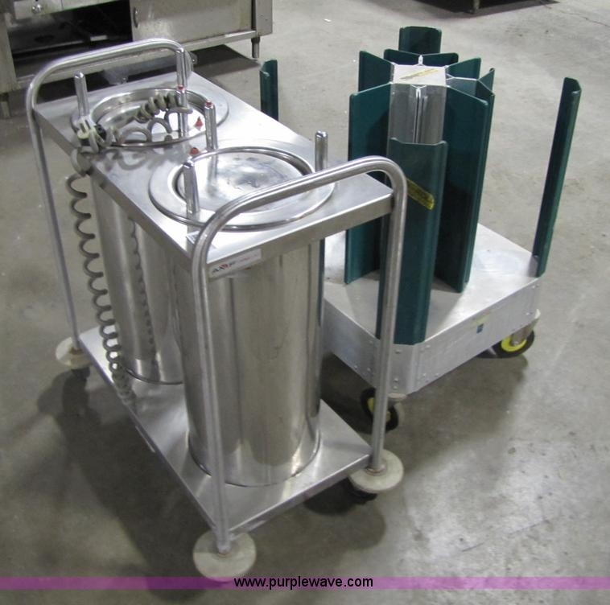
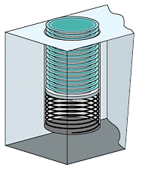
Last In First Out (LIFO) Stack of Plates
Call Stack

Slide 6
// Compute factorial of a number
// Recursive implementation
void setup() {}
void draw() {}
void mousePressed() {
int f = factorial(10);
println(f);
}
int factorial( int i) {
if( i == 0) {
return 1;
} else {
int fim1 = factorial(i-1);
return i*fim1;
}
}
Call | i | fim1 | returns
factorial(10) | 10
factorial(9) | 9

Slide 7
// Compute factorial of a number
// Recursive implementation
void setup() {}
void draw() {}
void mousePressed() {
int f = factorial(10);
println(f);
}
int factorial( int i) {
if( i == 0) {
return 1;
} else {
int fim1 = factorial(i-1);
return i*fim1;
}
}
Call | i | fim1 | returns
factorial(10) | 10
factorial(9) | 9
factorial(8) | 8

Slide 8
// Compute factorial of a number
// Recursive implementation
void setup() {}
void draw() {}
void mousePressed() {
int f = factorial(10);
println(f);
}
int factorial( int i) {
if( i == 0) {
return 1;
} else {
int fim1 = factorial(i-1);
return i*fim1;
}
}
Call | i | fim1 | returns
factorial(10) | 10
factorial(9) | 9
factorial(8) | 8
factorial(7) | 7
factorial(6) | 6
factorial(5) | 5
factorial(4) | 4
factorial(3) | 3
factorial(2) | 2
factorial(1) | 1
factorial(0) | 0 | -- | 1

Slide 9
// Compute factorial of a number
// Recursive implementation
void setup() {}
void draw() {}
void mousePressed() {
int f = factorial(10);
println(f);
}
int factorial( int i) {
if( i == 0) {
return 1;
} else {
int fim1 = factorial(i-1);
return i*fim1;
}
}
Call | i | fim1 | returns
factorial(10) | 10
factorial(9) | 9
factorial(8) | 8
factorial(7) | 7
factorial(6) | 6
factorial(5) | 5
factorial(4) | 4
factorial(3) | 3
factorial(2) | 2
factorial(1) | 1 | 1 | 1
factorial(0) | 0 | -- | 1

Slide 10
// Compute factorial of a number
// Recursive implementation
void setup() {}
void draw() {}
void mousePressed() {
int f = factorial(10);
println(f);
}
int factorial( int i) {
if( i == 0) {
return 1;
} else {
int fim1 = factorial(i-1);
return i*fim1;
}
}
Call | i | fim1 | returns
factorial(10) | 10
factorial(9) | 9
factorial(8) | 8
factorial(7) | 7
factorial(6) | 6
factorial(5) | 5
factorial(4) | 4
factorial(3) | 3
factorial(2) | 2 | 1 | 2
factorial(1) | 1 | 1 | 1
factorial(0) | 0 | -- | 1

Slide 11
// Compute factorial of a number
// Recursive implementation
void setup() {}
void draw() {}
void mousePressed() {
int f = factorial(10);
println(f);
}
int factorial( int i) {
if( i == 0) {
return 1;
} else {
int fim1 = factorial(i-1);
return i*fim1;
}
}
Call | i | fim1 | returns
factorial(10) | 10
factorial(9) | 9
factorial(8) | 8
factorial(7) | 7
factorial(6) | 6
factorial(5) | 5
factorial(4) | 4
factorial(3) | 3 | 2 | 6
factorial(2) | 2 | 1 | 2
factorial(1) | 1 | 1 | 1
factorial(0) | 0 | -- | 1

Slide 12
// Compute factorial of a number
// Recursive implementation
void setup() {}
void draw() {}
void mousePressed() {
int f = factorial(10);
println(f);
}
int factorial( int i) {
if( i == 0) {
return 1;
} else {
int fim1 = factorial(i-1);
return i*fim1;
}
}
Call | i | fim1 | returns
factorial(10) | 10 | 362880 | 3628800
factorial(9) | 9 | 40320 | 362880
factorial(8) | 8 | 5040 | 40320
factorial(7) | 7 | 720 | 5040
factorial(6) | 6 | 120 | 720
factorial(5) | 5 | 24 | 120
factorial(4) | 4 | 6 | 24
factorial(3) | 3 | 2 | 6
factorial(2) | 2 | 1 | 2
factorial(1) | 1 | 1 | 1
factorial(0) | 0 | -- | 1

Slide 13
String[] parts = new String[] {"a", "b", "c", "d"};
void setup() {}
void draw() {}
void mousePressed() {
String joined = reverseJoin(3);
println( joined );
}
String reverseJoin( int i ) {
if (i == 0) {
return parts[0];
}
else {
String rjim1 = reverseJoin(i-1)
return parts[i] + rjim1;
}
}
Call | i | parts[i] | rjim1 | returns
reverseJoin(3) | 3 | "d" | "cba" | "dcba"
reverseJoin(2) | 2 | "c" | "ba" | "cba"
reverseJoin(1) | 1 | "b" | "a" | "ba"
reverseJoin(0) | 0 | "a" | -- | "a"

Slide 14
Three ways to transform the coordinate system:
Translate
Move axes left, right, up, down …
Scale
Magnify, zoom in, zoom out …
Rotate
Tilt clockwise, tilt counter-clockwise …

Slide 15
Scale
All coordinates are multiplied by an x-scale-factor and a y-scale-factor.
The size of everything is magnified about the origin (0,0)
Stroke thickness is also scaled.
scale( factor );
scale( x-factor, y-factor );

Slide 16
void setup() {
size(500, 500);
smooth();
noLoop();
line(1, 1, 25, 25);
}

Slide 17
void setup() {
size(500, 500);
smooth();
noLoop();
scale(2,2);
line(1, 1, 25, 25);
}

Slide 18
void setup() {
size(500, 500);
smooth();
noLoop();
scale(20,20);
line(1, 1, 25, 25);
}

Slide 19
void setup() {
size(500, 500);
smooth();
noLoop();
scale(2,5);
line(1, 1, 25, 25);
}

Slide 20
Translate
The origin of the coordinate system (0,0) is shifted by the given amount in the x and y directions.
translate( x-shift, y-shift);

Slide 21
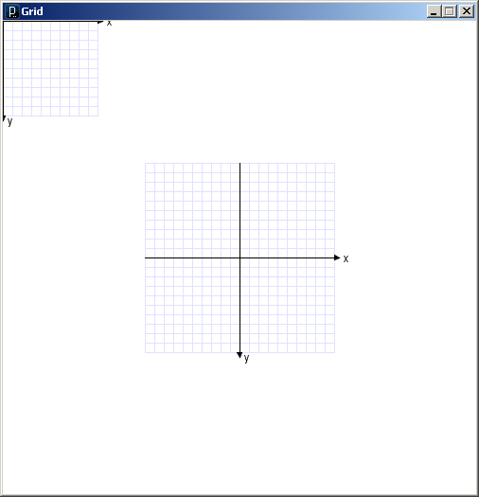
void draw() {
grid();
translate(250,250);
grid();
}
(250, 250)

Slide 22
Transformations can be combined
Combine Scale and Translate to create a coordinate system with the y-axis that increases in the upward direction
Axes can be flipped using negative scale factors
Order in which transforms are applied matters!

Slide 23
Rotate
The coordinate system is rotated around the origin by the given angle (in radians).
rotate( radians );

Slide 24
void draw() {
rotate( 25.0 * (PI/180.0) );
grid();
}

Slide 25
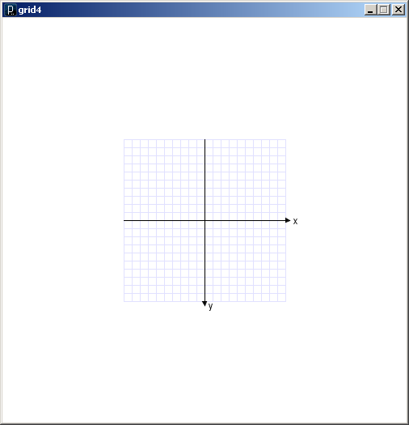
void draw() {
translate(250.0, 250.0);
//rotate( 25.0 * (PI/180.0) );
//scale( 2 );
grid();
}

Slide 26
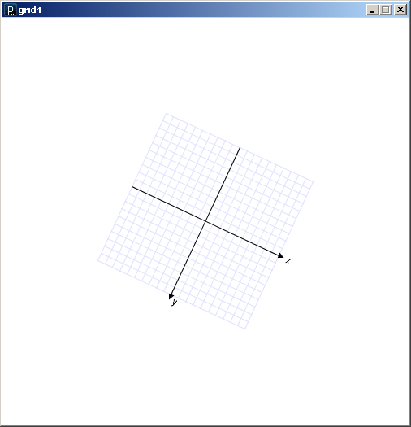
void draw() {
translate(250.0, 250.0);
rotate( 25.0 * (PI/180.0) );
//scale( 2 );
grid();
}

Slide 27
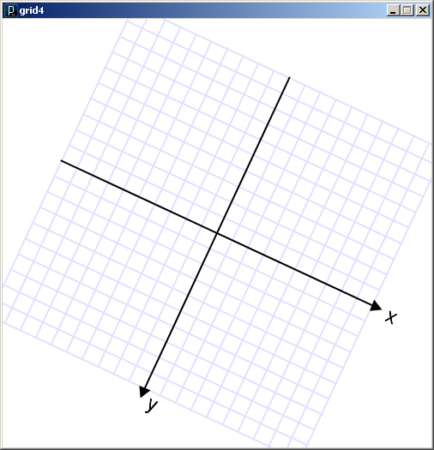
void draw() {
translate(250.0, 250.0);
rotate( 25.0 * (PI/180.0) );
scale( 2 );
grid();
}

Slide 28
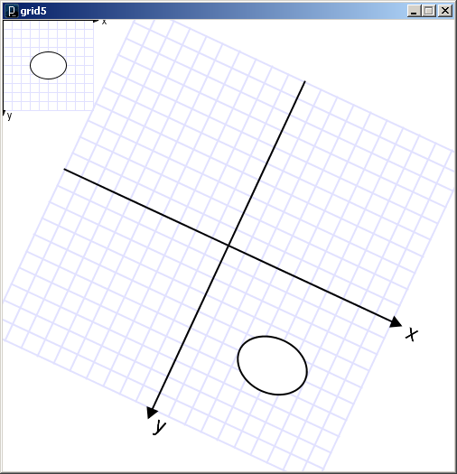
void draw() {
grid();
fill(255);
ellipse(50, 50, 40, 30);
translate(250.0, 250.0);
rotate( 25.0 * (PI/180.0) );
scale(2);
grid();
fill(255);
ellipse(50, 50, 40, 30);
}
grid5.pde

Slide 29
Last In First Out (LIFO) Stack of Plates
Transformation Matrix Stack

Slide 30
Transformation Matrix Stack
All transformations are matrix multiplications
Transformation matrices can be managed using the Matrix Stack. (Recall, a stack is LIFO)
All drawing commands are always multiplied by the current transformation matrix, which is the identity matrix by default
A transformation matrix can be temporarily pushed on to the Matrix Stack, and popped off when drawing is done.

Slide 31
pushMatrix()
Pushes a copy of the current transformation matrix onto the Matrix Stack
popMatrix()
Pops the last pushed transformation matrix off the Matrix Stack and replaces the current matrix
resetMatrix()
Replaces the current transformation matrix with the identity matrix
applyMatrix()
Multiplies the current transformation matrix with a given custom matrix.
printMatrix()
Prints the current transformation matrix in effect.

Slide 32
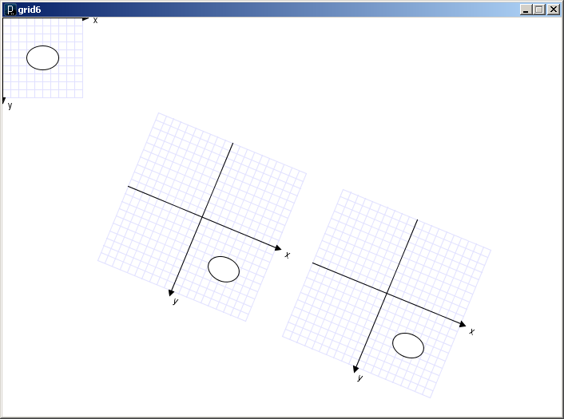
void draw() {
grid();
fill(255);
ellipse(50, 50, 40, 30);
translate(250, 250);
rotate(PI/8.0);
grid();
fill(255);
ellipse(50, 50, 40, 30);
translate(250, 0);
grid();
fill(255);
ellipse(50, 50, 40, 30);
}
relXform.pde

Slide 33
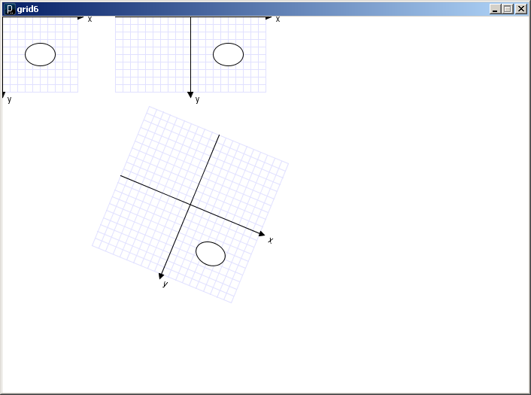
void draw() {
grid();
fill(255);
ellipse(50, 50, 40, 30);
pushMatrix();
translate(250, 250);
rotate(PI/8.0);
grid();
fill(255);
ellipse(50, 50, 40, 30);
popMatrix();
translate(250, 0);
grid();
fill(255);
ellipse(50, 50, 40, 30);
}
relXform.pde

Slide 34
Some things to remember:
Transformations are cumulative.
All transformations are cancelled each time draw() exits.
They must be reset each time at the beginning of draw() before any drawing.
Rotation angles are measured in radians
radians = (PI/180.0) * degrees
radians()
Order matters

Slide 35
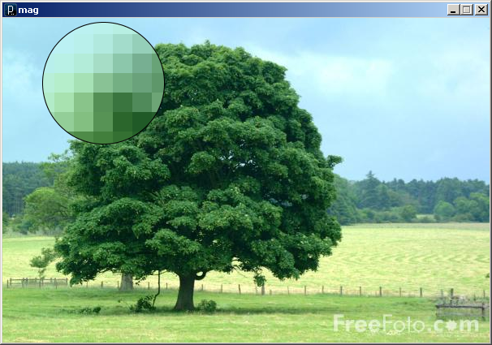
An image is an array of colors
0
1
2
3
…
98
99
100
101
102
103
…
198
199
200
201
202
203
…
298
299
300
301
302
303
…
398
399
400
401
402
403
…
498
499
500
501
502
503
…
598
599
600
601
602
603
…
698
699
700
701
702
703
…
798
799
800
801
802
803
…
898
899
…
…
…
…
…
…
…
Pixel : Picture Element
mag.pde

Slide 36
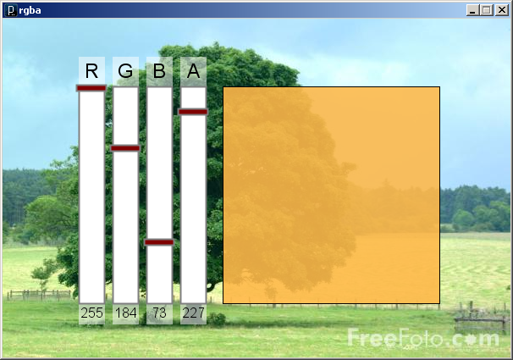
Color
A triple of bytes [0, 255]
RGB or HSB
Transparency (alpha)
How to blend a new pixel color with an existing pixel color
rgba.pde

Slide 37
Accessing the pixels of a sketch
loadPixels()
Loads the color data out of the sketch window into a 1D array of colors named pixels[]
The pixels[] array can be modified
updatePixels()
Copies the color data from the pixels[] array back to the sketch window

Slide 38
A 100-pixel wide image
First pixel at index 0
Right-most pixel in first row at index 99
First pixel of second row at index 100
0
1
2
3
…
98
99
100
101
102
103
…
198
199
200
201
202
203
…
298
299
300
301
302
303
…
398
399
400
401
402
403
…
498
499
500
501
502
503
…
598
599
600
601
602
603
…
698
699
700
701
702
703
…
798
799
800
801
802
803
…
898
899
…
…
…
…
…
…
…
The pixels[] array is one-dimensional
0
1
2
3
…
98
99
100
101
102
103
…
198
199
200
201
202
203
…

Slide 39
// whiteNoise
void setup() {
size(400, 300);
}
void draw() {
float b;
// Load colors into pixels array
loadPixels();
// Fill pixel array with a random grayscale value
for (int i=0; i<pixels.length; i++) {
b = random(0, 255);
pixels[i] = color(b);
}
// Update the sketch with pixel data
updatePixels();
}
See also colorNoise.pde

Slide 40
Accessing Pixels as a 2D Array
Pixels can be accessed as a 2D array using the following formula:
Index = y*width + x

Slide 41
// drawPixels
void setup() {
size(400, 400);
background(0);
}
void draw() {
if (mousePressed == true) {
// Load colors into the
// pixels array
loadPixels();
// Compute pixel location
// from mouse coordinates
int i = mouseY*width + mouseX;
// Set pixel color
pixels[i] = color(255);
// Update the sketch with pixel data
updatePixels();
}
}
drawPixels.pde

Slide 42
ArrayList
Constructors
ArrayList lst1 = new ArrayList();
ArrayList lst2 = new ArrayList(int initialSize);
Methods
size() // Returns the num of items held.
add(Object o) // Appends o to end.
add(int idx, Object o) // Inserts o at pos idx.
remove(int idx) // Removes item at pos idx.
get(int idx) // Gets items at idx. No removal.
set(int idx, Object o) // Replaces item at idx with o.
clear() // Removes all items.
isEmpty() // true if empty.
toArray() // returns an array that contains
// the contents of the list
When removing from an ArrayList, loop back to front

Slide 43
What does the following program print? Justify your answer if you’re not certain.
void setup() {
int n = op(5,3);
println( n );
}
int op (int val, int divisor) {
if (val < divisor) {
return val;
} else {
int v = op(val - divisor, divisor);
return v;
}
}
Which built-in mathematical operator does the op() function simulate?

Slide 44
Add the necessary transformations to draw() to render the rectangle at the center of the sketch, twice its size, and rotated by 45 degrees (PI/4 radians).
void setup() {
size(400, 400);
rectMode(CENTER);
}
void draw() {
// Add transformations here
rect( 0, 0, 50, 50);
}

Slide 45
Add the necessary code within the nested for-loops to color all pixels on the diagonal white, and the others black.
void setup() {
size(100,100);
loadPixels();
for (int y=0; y<height; y++) {
for (int x=0; x<width; x++) {
// Add code here
} // Closing brace for the x-loop
} // Closing brace for the y-loop
updatePixels();
}

